Slide 1
Level 1
Personal Safety
Incident Command System and
Personnel Accountability System

Slide 2

Is it worth the risk?

Slide 3
Recent Nation Wide Close Calls
http://www.firefighterclosecalls.com
Fire Captain Injured While Taking Fire Photos Off Duty In Canada - 4/24/12
Ohio Firefighter Falls Through Roof During Fire – 4/24/12
Firefighters Seriously Injured In California Crash – 4/24/12
Woman Killed In Fatal Texas Responding Crash – 4/24/12
Notes:
1. Tuesday, April 24, 2012 Jeff Daigle is a Captain in the Quebec City Fire Department and the webmaster for SPIQ.ca, which is the privately operated, but officially recognized web site for the Quebec Fire Department.
He was off duty yesterday on a day when he city was bombarded by high winds and driving rain. He responded to photograph an incident where a power line had fallen onto the balcony of a building and started a fire. Somehow, while shooting photos, he came in contact with the wire or with something that had become energized. He received 2nd and 3rd degree burns on multiple parts of his body and is in serious condition at the burn unit at Enfant-Jesus Hospital.
2. Tuesday, April 24, 2012 A roof collapses beneath a Forest Park firefighter this morning. Colerain's Fire Chief credits training with saving the crew member's life.
3. Tuesday, April 24, 2012 - 2 Los Angeles City Firefighters were hospitalized with serious injuries when their rescue ambulance crashed with a garbage truck in an intersection yesterday. A sanitation worker on the trash truck was also injured in the crash that took place about 1415 hours
4. Tuesday, April 24, 2012 El Paso Police Department officials have identified the 80-year-old woman killed Saturday after hitting an El Paso Fire Department truck as Dolores Gonzalez of the 5500 block of Timberwolf Drive.
Gonzalez died at Paisano and Trowbridge streets in Central El Paso after the green 2000 Honda Civic she was driving struck a fire truck that was responding to an emergency call, police said. The fire truck was traveling east on Trowbridge Drive, and Gonzalez was traveling north on Paisano Drive, police said. On Sunday, police officials continued to investigate the accident. "At this point in the investigation it appears Gonzalez disregarded a red traffic signal and drove into the intersection of Paisano and Trowbridge, where the Civic collided with the fire truck," said Det. Mike Baranyay, a police spokesman, in a written statement. Baranyay said Gonzalez was not wearing a seat belt at the time of the accident and was ejected from her car.

Slide 4
FxCo FRD Calls
Rapid Fire Progression Event, 1/2011
Near Electrocution, Truck 441, 8/2010
Firefighters Injured, 2/2010
Firefighter Struck by FRD Vehicle, 1/2009
Notes:
Read attached Executive Summaries

Slide 5
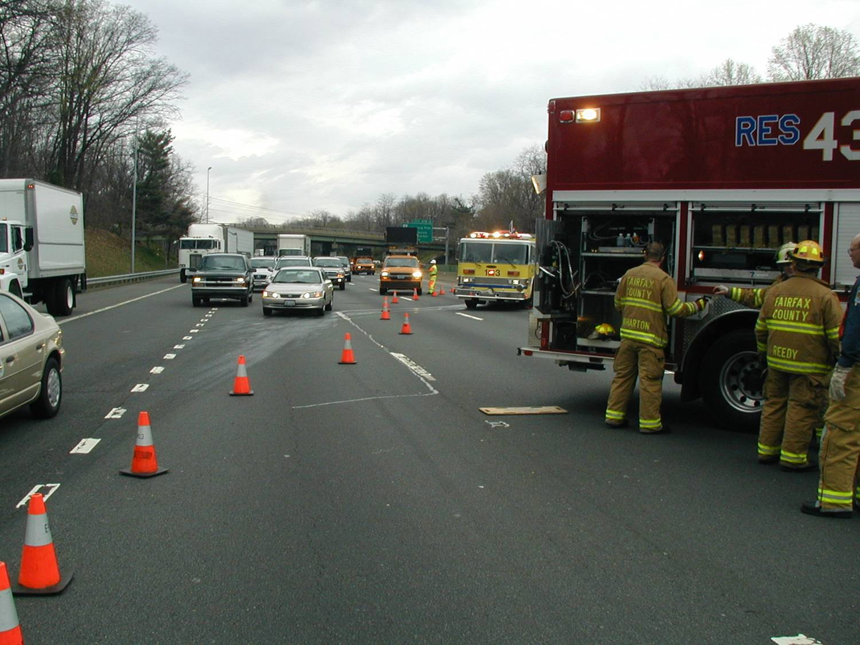
Personal Safety

Slide 6
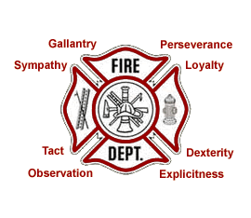
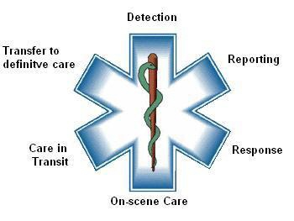
Which is More Dangerous?
EMS
or
FIRE

Slide 7

EMS
Runs the most calls (~77%)
Most injured patients
Most time responding
Heavy lifting
Exposure to disease
Mental stress
Wide array of calls
  Shootings, Cardiac Arrest, Stabbings, Suicides, Car Accidents, General Sickness, Pediatric Emergencies, OB/GYN

Slide 8
Body Substance Isolation (BSI)
Body substance Isolation is a practice of isolating YOURSELF from all body substances (blood, urine, saliva, tears, etc.) and taking Standard Precautions that promotes a practice of protective equipment use based on the premise that all patients are infectious. Standard Precautions is essentially management of two categories: work practice controls and personal protective equipment

Slide 9
We have an exposure reporting process and it’s time sensitive! We have a really good record of keeping our people safe.
Scene safety should always consider the potential for increasing ones measure of personal protection from what is considered the baseline level of protection….”Are we wearing the appropriate level of protection for this EMS incident”…should we be wearing that N95 or eye protection?
“Know thy self”…hopefully means know your vaccination/childhood disease history before you jump into the patient care arena

Slide 10
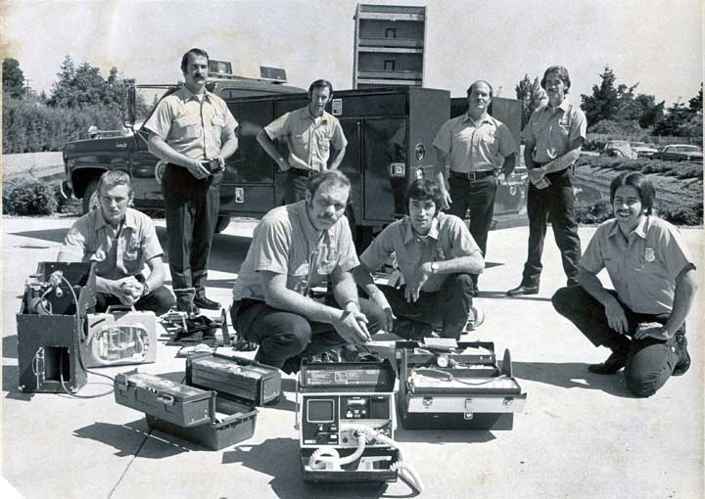
EMS Safety 1979
No Gloves
No Eye Protection
No Masks
No Hepatitis Shots
No Gear

Slide 11
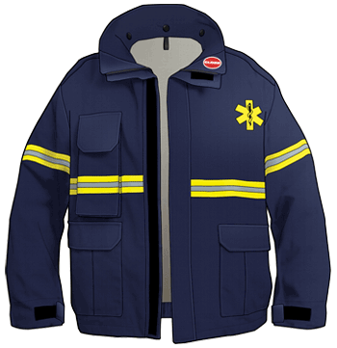
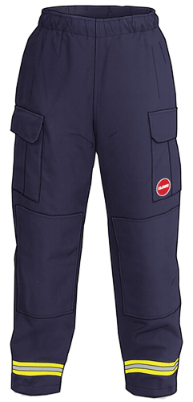
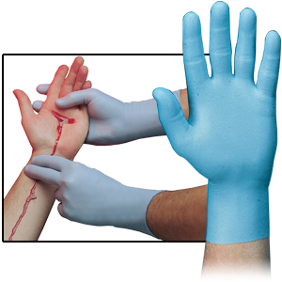
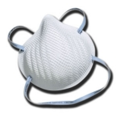

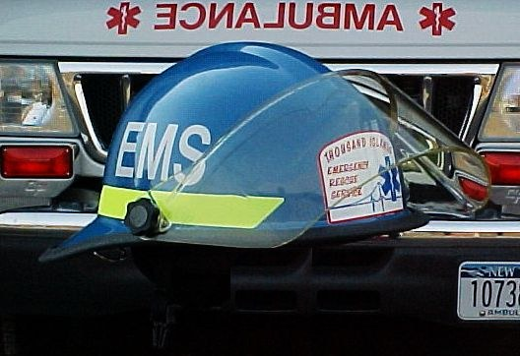
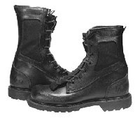
Personal Protective Equipment
EMS Jacket
EMS Pants
Latex Gloves
N95 Mask
Safety Glasses
Helmet
Steel Toe Shoes

Slide 12
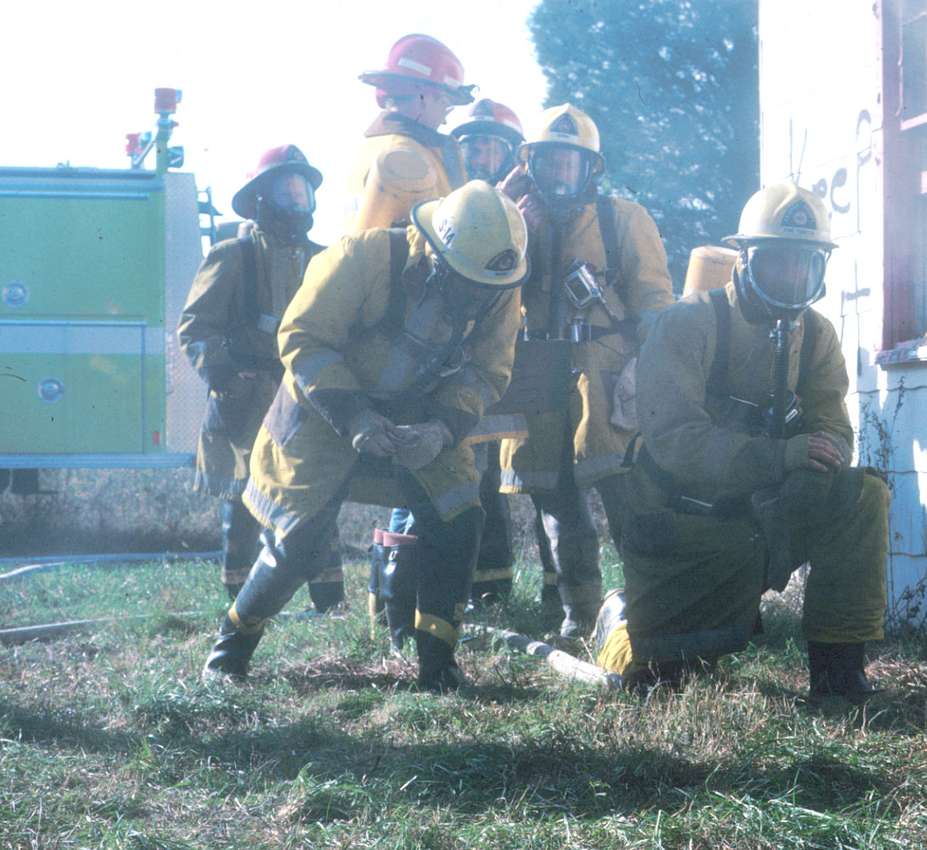
Fire Safety 1979
Nomex bunker coat
  Heavy, bulky, steam burns
No hoods – feel the heat
¾ Boots in day and summer nights, bunker pants for winter nights
Scott 2A – demand/positive pressure
No eye or hearing protection
SCBA optional

Slide 13
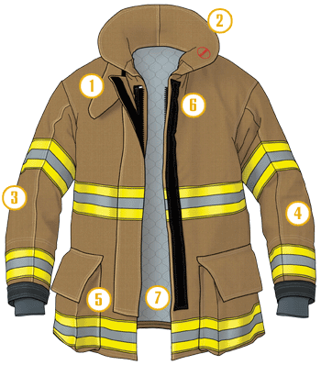
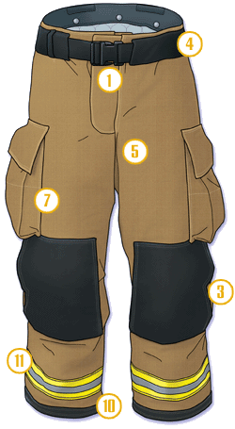
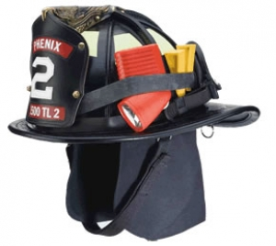
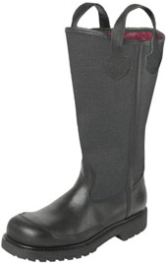
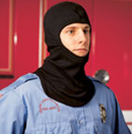
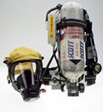

Personal Protective Equipment
Turnout Jacket
Turnout Pants
Fire Gloves
Helmet
Fire Boots
Nomex Hood
Scott SCBA (self-contained breathing apparatus)

Slide 14
Safety Responsibilities
As an EMT, what are your responsibilities in regards to safety?
  Personal Safety
  Crew Safety
  Patient Safety
  Bystander Safety
  Everyone watches out for everyone

Slide 15
Impacts to Safety
Bodily Fluids (Blood, Saliva, etc.)*
Bloodborne Pathogens (Hep B, Hep C, HIV/AIDS)*
Airborne Diseases (Tuberculosis, Bird Flu, Flu, Meningitis)*
Scene Safety (Traffic, Violence, Hazardous Materials, Fires)
Weather
Your Health and Remaining Within Your Limits
* Bodily fluids, Blood borne Pathogens as well as airborne diseases are covered extensively in the Infectious Control EMT-B class

Slide 16
Personal Health
Join a gym to get and stay good shape
“Know thy Self”
  Pre-existing conditions
  Conditioning/Strength/Endurance
WELL-FIT center (14725-E Flint Lee Road, Chantilly, VA 20151) open to operational and admin personnel
With identification, Fairfax County operational volunteers (FF and EMS Only) get free basic use of the Fairfax County Park Authority recreation facilities (gym, pool, etc.) 5 visits per month. (www.fairfaxcounty.gov/parks/recenter.htm)

Slide 17
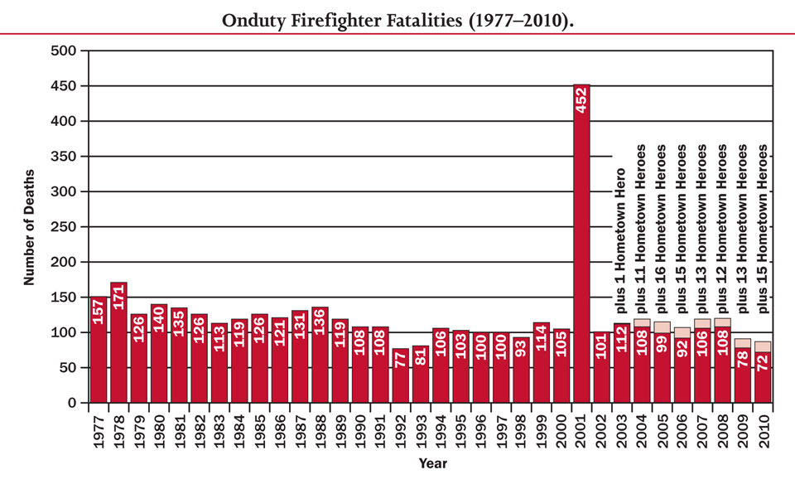
U.S. Fire Administration
Firefighter Fatalities in the United States
Notes:
81 on-duty firefighter fatalities in the United States as a result of incidents that occurred in 2011. This represents an almost seven percent decrease from the 87 fatalities reported for 2010. The 81 fatalities occurred in 33 states, one U.S. territory, and one overseas U.S. military facility. Texas experienced the highest number of fatalities (seven). North Carolina experienced six firefighter deaths and was the only other state with five or more firefighter fatalities.
“In 2004 at the initial Life Safety Summit, a number of fire service leaders did not believe we would complete a calendar year with less than 100 firefighter on-duty deaths,” U.S. Fire Administrator Ernest Mitchell said. "We broke through that perceived barrier in 2009, 2010, and now in 2011! We salute and congratulate our fire service family and pledge to continue working closely with the entire fire service community and its partners to maintain and even accelerate this downward trend in on-duty firefighter deaths.”
Heart attacks were responsible for the deaths of 48 firefighters (59%) in 2011, nearly the same proportion of firefighter deaths from heart attack or stroke (60%) in 2010. Ten on-duty firefighters died in association with wildland fires, the lowest number of annual firefighter deaths associated with wildland fires since 1996. Fifty-four percent of all firefighter fatalities occurred while performing emergency duties. Only three firefighters were killed in vehicle collisions.
2011 firefighter fatality statistics are provisional and may change as the USFA contacts State Fire Marshals to verify the names of firefighters reported to have died on duty during 2011. The final number of firefighter fatalities will be reported in USFA's annual firefighter fatality report, expected to be available by July 2012.

Slide 18
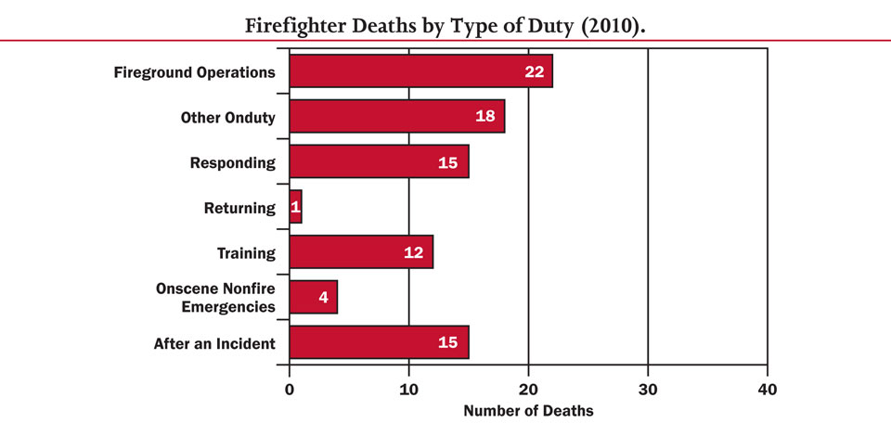
You are encouraged to read the U.S. Fire Administration, Firefighter Fatalities
in the United States in 2010 report which is on your reference CD

Slide 19
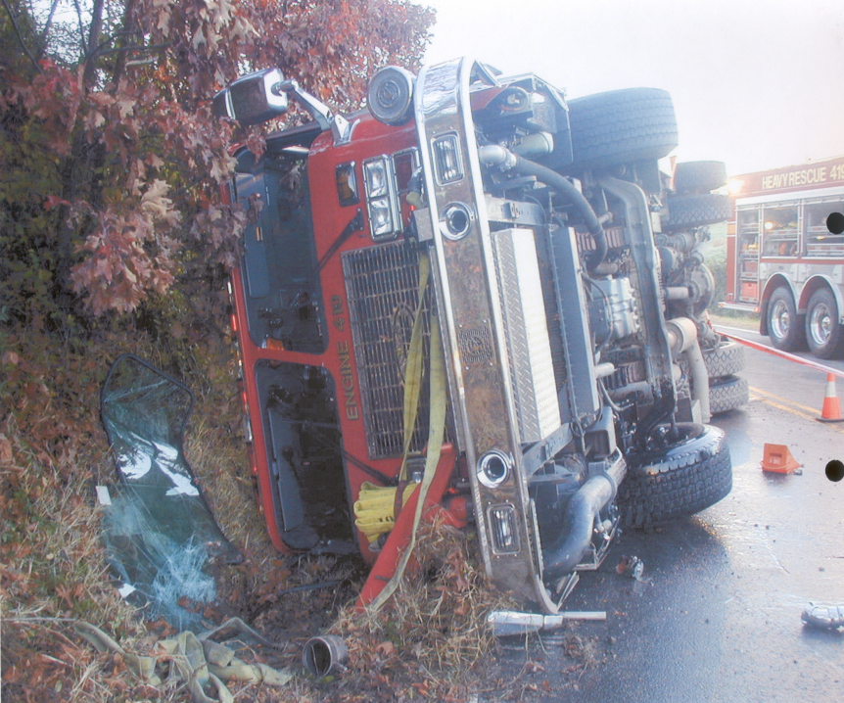
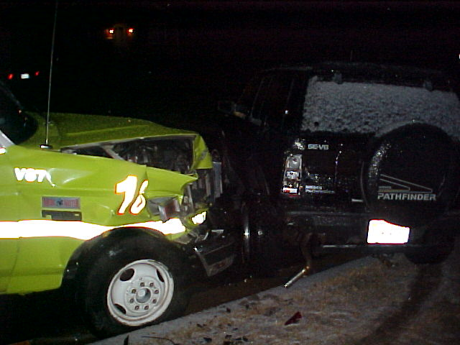
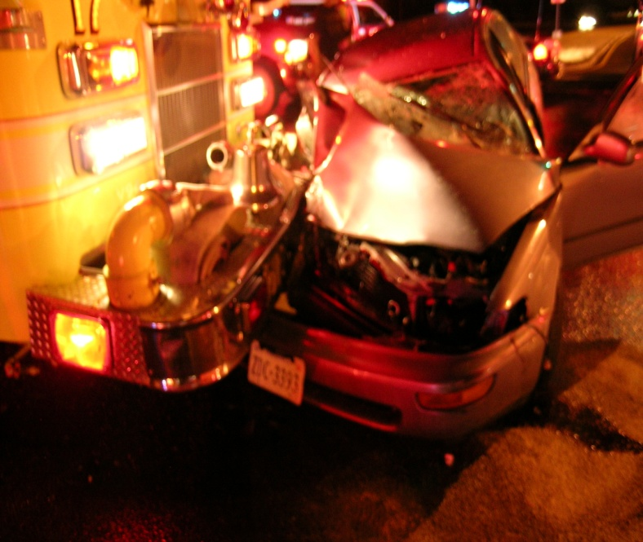
Accidents Happen

Slide 20
What Can I Do?
Human factors often cited as cause of injuries, job related illness and death.
Training, fitness/health, and attitude impact safety.
Proper training and drills help to prevent injuries.
A Firefighter/EMT's body must be able to handle stress.
Mental health is equally important

Slide 21
Training
Regular training is important!!
Good training leads to good performance
If you ride only the bare minimum a month, chances are you are rusty on most of your skills
Work with EMT classes help out during fire school.

Slide 22
Scene Safety
Always ask yourself, is this scene safe for my crew and I?
  Traffic Accidents
  Water Rescue
  Dangerous EMS Calls

Slide 23
Traffic Accidents
Exit apparatus on shoulder side
Position properly
Wear reflective vest/coat
No amount of visibility will prevent you from getting hit. Face traffic.
Look in driver’s eyes - are they looking at you?
Remain vigilant

Slide 24
Dangerous EMS Calls
Domestic disputes
Violence - shootings, stabbings, beatings, overdoses
Alcohol
Dogs
Be alert and observant at all times to patient as well as bystanders
Let the police secure the scene
Retreat---Radio---Re-Evaluate

Slide 25
Stress
Psychological
Physical
Environmental
Peer pressure

Slide 26
Psychological Stress
Death and injury of patients esp. children
High noise and confusion during fires
Lack of visibility during fires
Emotional compassion
Pressure to perform

Slide 27
Physical Stress
Hard work
Lifting and carrying heavy patients
Wearing full gear during heavy exertion
Zero to full speed

Slide 28
Environmental Stress
Weather
Noise
Heat from PPE
Bunkroom (Alerting System)

Slide 29
Weather
Icy & Cold Conditions
  Slips and Falls
  Hypothermia
Hot Conditions
  Hyperthermia
Wet Conditions
  Hypothermia

Slide 30
Hazardous Materials*
Positioning
  Upwind and Uphill
Prevent crew and self contamination
Isolate and Deny Entry
* Hazardous Materials will be covered extensively in the Haz-Mat Level 1 class

Slide 31
Mayday
Signal 1
Mayday
Emergency Radio SOPs

Slide 32
Reporting Injuries
Notify OIC
Station logbook
Proper forms
Yellow insurance card for treatment

Slide 33
What Can I Do to Protect Myself?
Wear your seatbelt
Frequently wash hands
Always utilize PPE
Keep the unit sanitized
Hydrate
Physically Fit
Take advantage of mandatory annual physicals
Be Smart

Slide 34
Responding From Home
Too many Line of Duty Deaths occur because of responses by firefighters (usually volunteer) that are killed in vehicle crashes in private vehicles during responses to incident scenes and fire stations as part of a emergency incident response.
  In 2008 six firefighters were killed in crashes that involved personal vehicles, all while responding to an emergency. In at least four of the six fatalities, the firefighter was not wearing a seatbelt (two unknown). Three of the four firefighters without seatbelts were ejected from their vehicle.

Slide 35
Responding from Home cont’d
FxCo does not permit personnel to use additional lighting on POVs (which is permitted in other counties of the Commonwealth) to disregard speed limits to respond to an emergency call / fill.
Personnel when responding to requests for emergency fills ARE to proceed in accordance with all State Traffic Laws and having due regard for the weather conditions.

Slide 36
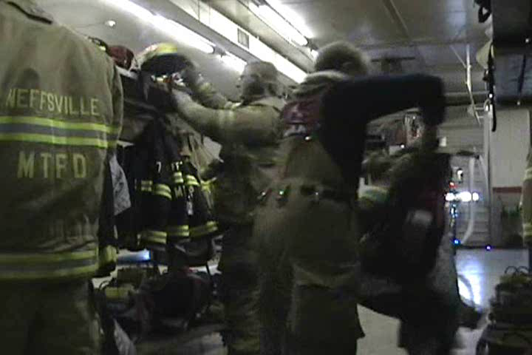
Safest Thing We Wear

Slide 37
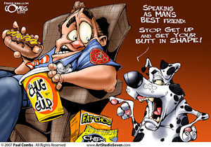
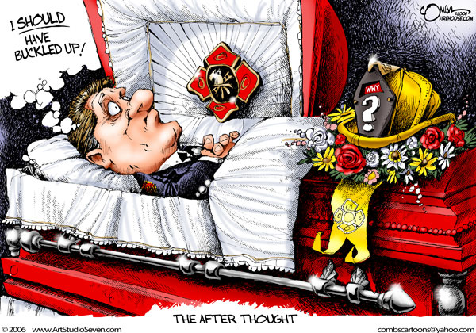
Who Is Responsible
For Your Personal Safety
YOU

Slide 38
Multimedia
http://www.safeprogram.com
http://www.everyonegoeshome.com
http://www.firefighterclosecalls.com
http://www.firefighternearmiss.com
http://www.nvfc.org
http://respondersafety.com
You are strongly encouraged to visit these web-sites

Slide 39
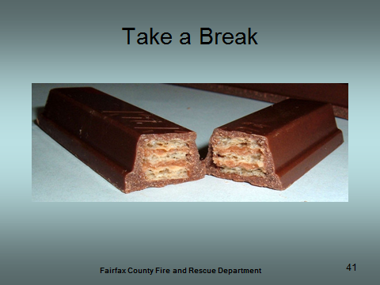
Wrap Up
Questions
Comments
Notes:
Take a break before next section

Slide 40
Incident Command System
and
Personnel Accountability System
Notes:
This presentation is intended to introduce ICS concepts, describe the everyday application if ICS in Fairfax County, and introduce the personnel accountability system used in Fairfax County.

Slide 41
Objectives
Understand the Basic Concepts of ICS
Your Role in the ICS System
Purpose of Personnel Accountability System
Understand the Components and Procedures
Your Responsibilities

Slide 42
Introduction
Management of an emergency incident, regardless of its size and its location, is essential to minimize confusion and increase the safety of the emergency responders and civilians involved
All personnel involved in the incident or event must understand common concepts of command and control used to manage incidents

Slide 43
ICS

Slide 44
WHAT IS ICS?
A standardized, on-scene, all-hazard incident management concept.
Establishes common processes for planning and management of resources.
Allows its users to adopt an integrated organizational structure to match the complexities and demands of single or multiple incidents without being hindered by jurisdictional boundaries.
Notes:
Can be used by both private and public sectors for incidents large and small.

Slide 45




HISTORY
Developed in the 1970’s from California’s experiences in fighting wildfires
In response to attacks on September 11, President George W. Bush issued Homeland Security Presidential Directive (HSPD-5) in February 2003.
Notes:
Developed in the 1970’s when, as a result of several wildland fires, many people died or were injured and property damage ran into the millions. Surprisingly, studies found that response problems were far more likely to result from INADEQUATE MANAGEMENT than from any other single reason.
Weaknesses in incident management were often due to:
Lack of accountability, including unclear chains of command and supervision.
Poor communication due to both inefficient uses of available communications systems and conflicting codes and terminology.
Lack of an orderly, systematic planning process.
No common, flexible, predesigned management structure that enables commanders to delegate responsibilities and manage workloads efficiently.
No predefined methods to integrate interagency requirements into the management structure and planning process effectively.
In response to attacks of 9/11 HSPD-5 called for a National Incident Management System (NIMS) and identified steps for improved coordination of Federal, State, local, and private industry response to incidents and described the way these agencies will prepare for such a response. One of the key features of NIMS is the Incident Command System.
With so much at stake (lives, property & the environment), we must effectively manage our response efforts. The Incident Command System, or ICS, allows us to do so. ICS is a proven management system based on best practices. Additionally, adopting the use of the ICS is a condition of receiving federal funding. This is why you must complete this training, successfully pass the ICS-100 test and if you graduate, take and complete ICS-200 & 700 prior to the end of your probie year.

Slide 46
WHAT IS HSPD-5
Homeland Security Presidential Directive 5 serves to enhance the ability of the United States to manage domestic incidents by establishing a single, comprehensive national incident management system.
This management system is designed to cover the prevention, preparation, response, and recovery from terrorist attacks, major disasters, and other emergencies.

Slide 47
HSPD-5
The implementation of such a system would allow all levels of government throughout the nation to work efficiently and effectively together.
The directive gives further detail on which government officials oversee and have authority for various parts of the national incident management system, as well making several amendments to various other HSPDs.

Slide 48
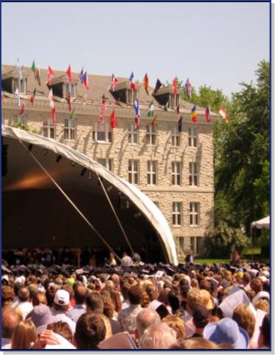

WHY USE ICS?
1. It Works!
2. Mandates
Notes:
Explain ICS is a feature of NIMS
What ? . . . NIMS provides a consistent nationwide template . . .
Who? . . . to enable Federal, State, tribal, and local governments, the private sector, and nongovernmental organizations to work together . . .
How? . . . to prepare for, prevent, respond to, recover from, and mitigate the effects of incidents regardless of cause, size, location, or complexity . . .
Why? . . . in order to reduce the loss of life and property, and harm to the environment.
Without ICS, incident responses typically:
Lack accountability.
Have poor communications.
Use unsystematic planning processes.
Are unable to efficiently integrate responders
ICS helps to ensure:
The safety of responders, workers, and others.
The achievement of response objectives.
The efficient use of resources.

Slide 49
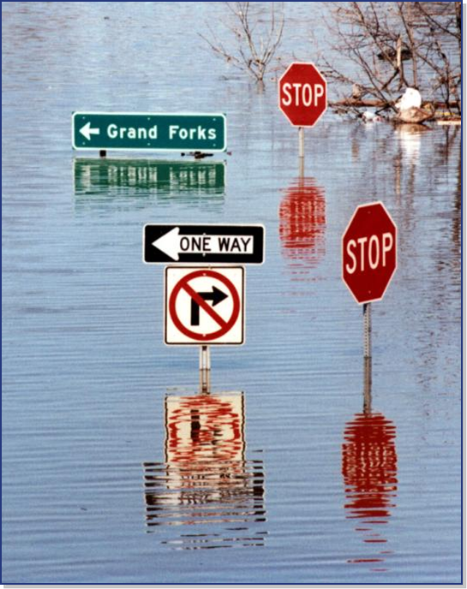
WHEN IS ICS USED?
ICS can be used to manage:
Natural hazards.
Technological hazards.
Human-caused hazards.
Planned events.

Slide 50
WHAT IS AN INCIDENT?
…an occurrence, either caused by human or natural phenomena, that requires response actions to prevent or minimize loss of life, or damage to property and/or the environment.
Examples include:
Fire, both structural and wildland
Natural disasters
Human & animal disease outbreaks
Planned events such as parades or demonstrations
Criminal acts & crime scene investigations
Terrorist incidents, including WMD events
National Special Security Events
Hazardous materials incidents
Notes:
The examples shown up on the screen illustrate the wide variety of incidents (remember the definition) which may require the implementation of ICS.
CAN ANYONE EXPLAIN WHY AN EVENT, SUCH AS A COMMUNITY PARADE, BE DEFINED AS AN INCIDENT? (Answer: The definition includes human phenomena that require response action to prevent or minimize loss of life…potentially, **if a parade takes place on an extremely hot day (the 4th of July for example) many people could be overcome by heat exhaustion. Statistically, ANY large group of people will include someone with a medical condition that the law of averages will dictate may have a medical event. If it is not properly planned for and managed, then even a benign event/incident, may lead to loss of life, damage to property or the environment).
Now imagine a terrorist event, a fire, a chemical release, an outbreak of Avian flu….those are incidents that require an even higher degree of management/command.

Slide 51
ICS IS DESIGNED TO:
Meet the needs of incidents of any kind or size.
Allow personnel from a variety of agencies to meld rapidly into a common management structure.
Provide logistical and administrative support to operational staff.
Be cost effective by avoiding duplication of efforts.
Notes:
Designers of the system recognized early that ICS must be interdisciplinary and organizationally flexible to meet these management challenges:
Meet the needs of incidents of any kind or size.
**Allow personnel from a variety of agencies to meld rapidly into a common management structure.
Provide logistical and administrative support to operational staff.
Be cost effective by avoiding duplication of efforts.
ICS consists of procedures for controlling personnel, facilities, equipment, and communications. It is a system designed to be used or applied from the time an incident occurs until the requirement for management and operations no longer exists.

Slide 52
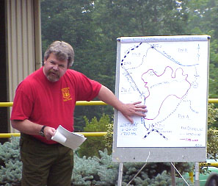
ICS FEATURES
Common terminology & clear text
Modular organization
Management by objectives
Notes:
Common terminology & clear text. **An essential method for ensuring the ability to communicate is by using common terminology and clear text. Do not use radio codes, agency-specific codes, or jargon. ICS establishes common terminology allowing diverse incident management and support entities to work together. This common terminology defines: Organizational Functions, Resource Descriptions, Incident Facilities and Position Titles. Each of these areas will be covered in more detail.
Modular organization. The ICS organizational structure develops in a top-down, modular fashion that is based on the size and complexity of the incident, as well as the specifics of the hazard environment created by the incident. As incident complexity increases, the organization expands from the top down as functional responsibilities are delegated. The ICS organizational structure is flexible. As the ICS organizational structure expands, the number of management positions also expands to adequately address the requirements of the incident. Only those functions or positions necessary for a particular incident will be filled.
Management by objectives. This is an approach used to communicate functional actions throughout the entire ICS organization. It can be accomplished through the incident action planning process.

Slide 53
COMMON TERMINOLOGY – NO CODES!
Using common terminology helps define:
  Organizational functions.
  Incident facilities.
  Resource descriptions.
  Position titles.
All communications will be in PLAIN ENGLISH
Notes:
10-65 in Fairfax meant “Police Department”, in other jurisdictions it means “Net message assignment”
10-61 in Fairfax meant “Dead person”, in other jurisdictions it means “Isolate self for message”

Slide 54

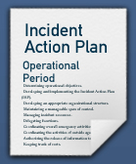
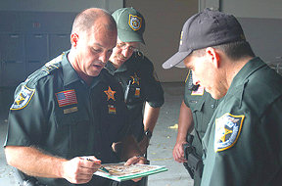
ICS FEATURES
Reliance on an Incident Action Plan
Manageable Span of Control
Notes:
Reliance on an Incident Action Plan. In ICS, considerable emphasis is placed on developing effective Incident Action Plans. At the simplest level, all Incident Action Plans must have four elements:
What do we want to do?
Who is responsible for doing it?
How do we communicate with each other?
What is the procedure if someone is injured?
EVERY INCIDENT MUST HAVE A VERBAL OR WRITTEN INCIDENT ACTION PLAN. **The purpose of this plan is to provide all incident supervisory personnel with direction for actions to be implemented during the operational period identified in the plan.
**Incident Action Plans include the measurable strategic operations to be achieved and are prepared around a timeframe called an Operational Period.
Manageable Span of Control.**Span of control pertains to the number of individuals or resources that one supervisor can manage effectively during emergency response incidents or special events. Maintaining an effective span of control is particularly important on incidents where safety and accountability are a top priority.
The type of incident, nature of the task, hazards and safety factors, and distances between personnel and resources all influence span of control considerations.
Effective span of control on incidents may vary from three (3) to seven (7), and a ratio of one (1) supervisor to five (5) reporting elements is recommended.

Slide 55
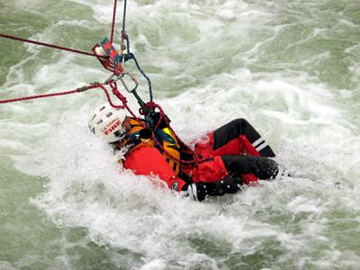
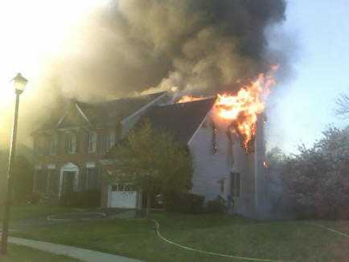
INCIDENT PRIORITIES
#1: Life Saving
#2: Incident Stabilization
#3: Property Preservation
Notes:
Incident priorities, which dictate the goals/objectives of every Incident Action Plan are based on the following:
#1: Life Saving
#2: Incident Stabilization
#3: Property Preservation
Within those priorities there is always the discussion of the risk-benefit analyses. In its most simplified form it boils down to three statements.
We will risk a lot, to save a lot (meaning life)
We will risk some, to save some
We will risk little to save little (notice burning house-house is not tenable for life, house is not salvageable, the next day the insurance company will have a bulldozer there flattening it out)

Slide 56
INCIDENT FACILITIES
Incident Command Post (ICP)
Notes:
The Incident Command Post (ICP) is the location from which the Incident Commander oversees all incident operations. The ICP may be located in a vehicle, trailer, tent, or within a building. **The ICP will be positioned outside of the present and potential hazard zone but close enough to the incident to maintain command. The ICP will be designated by the name of the incident, e.g., Trail Creek ICP.

Slide 57
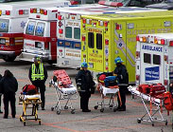
INCIDENT FACILITIES
Staging Areas
Notes:
**Staging Areas are temporary locations at an incident where personnel and equipment are kept while waiting for tactical assignments. The resources in the Staging Area are always in available status. Staging Areas should be located close enough to the incident for a timely response, but far enough away to be out of the immediate impact zone.

Slide 58
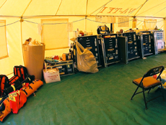
INCIDENT FACILITIES
Base
Notes:
**A Base is the location from which primary logistics and administrative functions are coordinated and administered. There is only one Base per incident, and it is designated by the incident name. The Base is established and managed by the Logistics Section. The resources in the Base are always out-of-service.

Slide 59
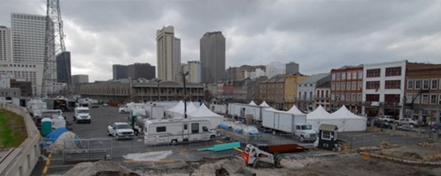
INCIDENT FACILITIES
Camp
Notes:
**A Camp is the location where resources may be kept to support incident operations if a Base is not accessible to all resources. Camps are temporary locations within the general incident area, which are equipped and staffed to provide food, water, sleeping areas, and sanitary services. Not all incidents will have Camps.

Slide 60
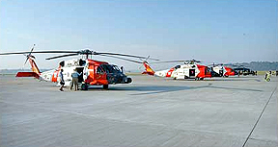

INCIDENT FACILITIES
Helibase
Helispot
Notes:
A Helibase is the location from which helicopter-centered air operations are conducted. Helibases are generally used on a more long-term basis and include such services as fueling and maintenance.
Helispots are more temporary locations at the incident, where helicopters can safely land and take off.

Slide 61
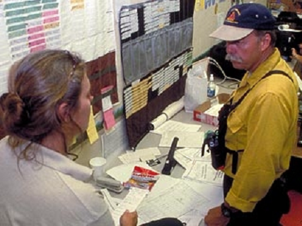
ICS CONCEPTS
Resource Management
  Tactical
  Support
Integrated Communications
Notes:
Resource Management. ICS resources can be factored into two categories:
Tactical Resources: Personnel and major items of equipment that are available or potentially available to the Operations function on assignment to incidents are called tactical resources and are classified as one of the following:
Assigned: Assigned resources are working on an assignment under the direction of a Supervisor.
Available: Available resources are assembled, have been issued their equipment, and are ready for immediate assignment.
Out-Of-Service: Out-of-service resources are not ready for available or assigned status.
Support Resources: All other resources required to support the incident. Food, communications equipment, tents, supplies, and fleet vehicles are examples of support resources.
Integrated Communications. The use of a common communications plan is essential for ensuring that responders can communicate with one another during an incident. Communication equipment, procedures, and systems must operate across jurisdictions (interoperability).

Slide 62
ICS CONCEPTS
Chain of Command/Unity of Command
Transfer of Command
Notes:
Chain of Command/Unity of Command. Chain of Command means that there is an orderly line of authority within the ranks of the organization, with lower levels subordinate to, and connected to, higher levels. Unity of command means that every individual is accountable to only one designated supervisor to whom they report at the scene of an incident. The principles clarify reporting relationships and eliminate the confusion caused by multiple, conflicting directives.
Transfer of Command is the process of moving the responsibility for incident command from one Incident Commander to another. Transfer of command may take place when:
A more qualified person assumes command.
The incident situation changes over time, resulting in a legal requirement to change command.
Changing command makes good sense, e.g., an Incident Management Team takes command of an incident from a local jurisdictional unit due to increased incident complexity.
There is normal turnover of personnel on long or extended incidents, i.e., to accomodate work/rest requirements.
The incident response is concluded and incident responsibility is transferred back to the home agency.
The transfer of command process always includes a transfer of command briefing, which may be oral, written, or a combination of both.

Slide 63
ICS CONCEPTS
Accountability – effective accountability is essential. The following guidelines must be adhered to:
  Check-In
  Incident Action Plan
  Unity of Command
  Span of Control
  Resource Tracking
Notes:
Accountability. Effective accountability during incident operations is essential at all jurisdictional levels and within individual functional areas. The following guidelines must be adhered to:
Check-In: All responders, regardless of agency affiliation, must report in to receive an assignment in accordance with the procedures established by the Incident Commander.
Incident Action Plan: Response operations must be directed and coordinated as outlined in the IAP.
Unity of Command: Each individual involved in incident operations will be assigned to only one supervisor.
Span of Control: Supervisors must be able to adequately supervise and control their subordinates, as well as communicate with and manage all resources under their supervision.
Resource Tracking: Supervisors must record and report resource status changes as they occur.

Slide 64
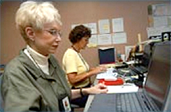
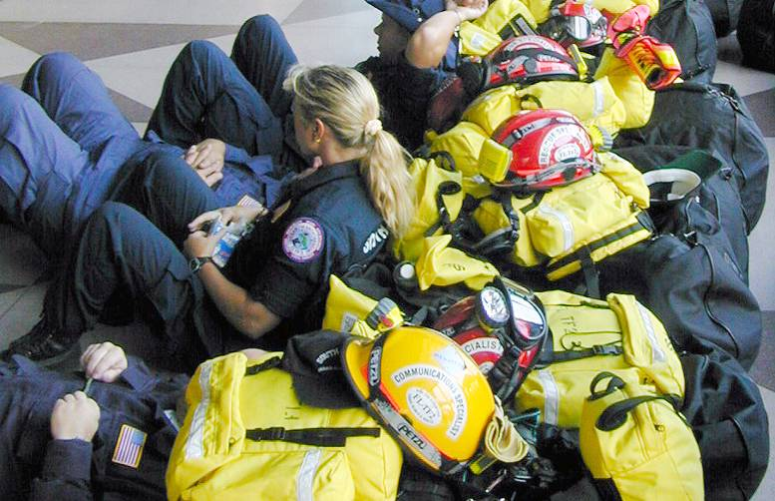
MOBILIZATION
Check-In at the Incident
  Among other things, check-in is critical to ensure personnel accountability
Notes:
When mobilized for any incident or event, the situation must be assessed and response planned. Resources must be organized, assigned and directed to accomplish the incident objectives. As they work, resources must be managed to adjust to changing conditions. Managing resources safely and effectively is the most important consideration at an incident. Therefore, personnel and equipment should respond only when requested or when dispatched by an appropriate authority.
Check-In at the Incident. Check-in officially logs you in at the incident. The check-in process and information helps to:
Ensure personnel accountability.
Track resources.
Prepare personnel for assignments and reassignments.
**Locate personnel in case of an emergency.
Establish personnel time records and payroll documentation.
Plan for releasing personnel.
Organize the demobilization process.

Slide 65
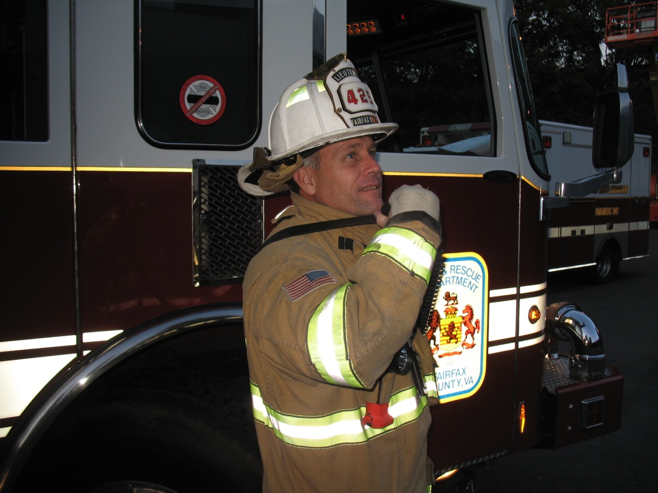
MOBILIZATION
Initial Incident Briefing
Communications Discipline
Notes:
**Initial Incident Briefing. After check-in, locate your incident supervisor and obtain your initial briefing. The briefing information helps you plan your tasks and communicate with others. Briefings received and given should include:
Current situation assessment.
Identification of your specific job responsibilities.
Identification of coworkers.
Location of work area.
Identification of eating and sleeping arrangements, as appropriate.
Procedural instructions for obtaining additional supplies, services, and personnel.
Operational periods/work shifts.
Required safety procedures and Personal Protective Equipment (PPE), as appropriate.
Communications Discipline. Important considerations related to communications include:
Observing strict radio/telephone procedures.
Using plain English in all communications.
Codes should not be used in radio transmissions.
Limit the use of discipline-specific jargon, especially on interdisciplinary incidents.
Limiting radio and telephone traffic to essential information only.
Plan what you are going to say.

Slide 66
ICS ORGANIZATION
ORGANIZATIONAL LEVEL | TITLE
Incident Command | Incident Commander
Command Staff | Officer
General Staff (Section) | Chief
Branch | Director
Division/Group | Supervisor
Unit | Leader
Strike Team/Task Force | Leader
Structure – no correlation between the ICS organization and the administrative structure of any single agency or jurisdiction
Sections – may be subdivided as needed, organization can expand or contract to meet the needs of the incident
Position Titles
Notes:
Structure. The ICS organization is unique but easy to understand. Remember, there is no correlation between the ICS organization and the administrative structure of any single agency or jurisdiction. **This is deliberate, because confusion over different position titles and organizational structures has been a significant stumbling block to effective incident management in the past.
For example, someone who serves as a Chief every day may not hold that title when deployed under an ICS structure.
Sections. Each of the primary ICS Sections may be subdivided as needed. The ICS organization has the capability to expand or contract to meet the needs of the incident.** A basic ICS operating guideline is that the person at the top of the organization is responsible until the authority is delegated to another person. Thus, on smaller incidents when these additional persons are not required, the Incident Commander will personally accomplish or manage all aspects of the incident organization.
Position Titles. To maintain span of control, the ICS organization can be divided into many levels of supervision. At each level, individuals with primary responsibility positions have distinct titles. Using specific ICS position titles serves three important purposes:
Titles provide a common standard for all users. For example, if one agency uses the title Branch Chief, another Branch Manager, etc., this lack of consistency can cause confusion at the incident.
** The use of distinct titles for ICS positions allows for filling ICS positions with the most qualified individuals rather than by seniority.
Standardized position titles are useful when requesting qualified personnel. For example, in deploying personnel, it is important to know if the positions needed are Unit Leaders, clerks,

Slide 67
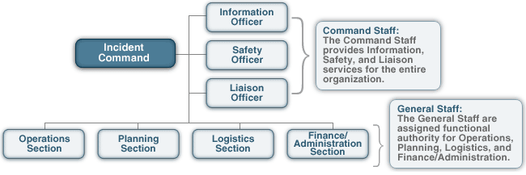
INCIDENT COMMAND
Notes:
Incident Command. On small incidents and events, one person, the Incident Commander, may accomplish all five management functions. **In fact, the Incident Commander is the only position that is always staffed in ICS applications. However, large incidents or events may require that these functions be set up as separate Sections within the organization.
**The Incident Commander has overall responsibility for managing the incident by objectives, planning strategies, and implementing tactics. The Incident Commander must be fully briefed and should have a written delegation of authority. Initially, assigning tactical resources and overseeing operations will be under the direct supervision of the Incident Commander.
Personnel assigned by the Incident Commander have the authority of their assigned positions, regardless of the rank they hold within their respective agencies.
Selecting and Changing Incident Commanders
As incidents expand or contract, change in jurisdiction or discipline, or become more or less complex, command may change to meet the needs of the incident.
Rank, grade, and seniority are not the factors used to select the Incident Commander. The Incident Commander is always a highly qualified individual trained to lead the incident response.
As mentioned before, formal transfer of command at an incident always requires a transfer of command briefing for the incoming Incident Commander and notification to all personnel that a change in command is taking place.
Expanding the Organization. As incidents grow, the Incident Commander may delegate authority for performance of certain activities to the Command Staff and the General Staff. The Incident Commander will add positions only as needed.

Slide 68
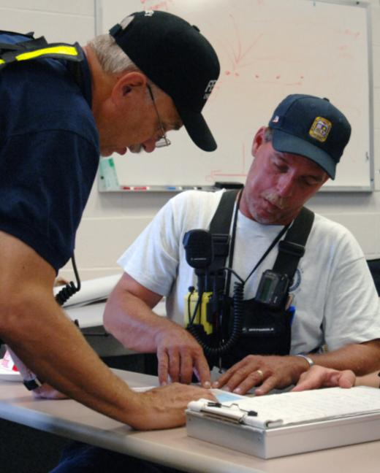
TRANSFER OF COMMAND
Moves the responsibility for command from one Incident Commander to another.
Must include a transfer of command briefing (which may be oral, written, or both).

Slide 69
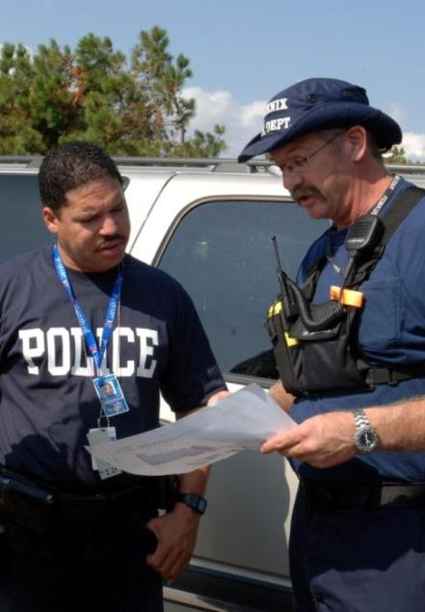
WHEN COMMAND IS TRANSFERRED
A more qualified Incident Commander arrives.
A jurisdiction or agency is legally required to take command.
Incident complexity changes.
The current Incident Commander needs to rest.

Slide 70
COMMAND STAFF
Notes:
Expanding the Organization. As incidents grow, the Incident Commander may delegate authority for performance of certain activities to the Command Staff and the General Staff. The Incident Commander will add positions only as needed.
Command Staff. Depending upon the size and type of incident or event, **it may be necessary for the Incident Commander to designate personnel to provide information, safety, and liaison services for the entire organization. In ICS, these personnel make up the Command Staff and consist of the:
**Public Information Officer, who serves as the conduit for information to internal and external stakeholders, including the media or other organizations seeking information directly from the incident or event.
**Safety Officer, who monitors safety conditions and develops measures for assuring the safety of all assigned personnel.
**Liaison Officer, who serves as the primary contact for supporting agencies assisting at an incident.
The Command Staff reports directly to the Incident Commander.

Slide 71
GENERAL STAFF
Notes:
General Staff. Expansion of the incident may also require the delegation of authority for the performance of the other management functions. The people who perform the other four management functions are designated as the General Staff. **The General Staff is made up of four Sections: Operations, Planning, Logistics, and Finance/Administration.
**Operations: Conducts tactical operations to carry out the plan as set by the IC. Develops the tactical objectives and organization, and directs all tactical resources.
**Planning: Prepares and documents the Incident Action Plan to accomplish the objectives, collects and evaluates information, maintains resource status, and maintains documentation for incident records.
**Logistics: Provides support, resources, and all other services needed to meet the operational objectives.
**Finance/Administration: Monitors costs related to the incident. Provides accounting, procurement, time recording, and cost analyses.
We will talk about the Incident Commander (IC) and the Operations Chief in more detail because of their critical responsibilities.

Slide 72
Operations Section: Major Activities
  Directs and coordinates all incident tactical operations.
  Is typically one of the first organizations to be assigned to the incident.
  Expands from the bottom up.
  Has the most incident resources.
  May have Staging Areas and special organizations.

Slide 73
Planning Section: Major Activities
  Collecting, evaluating, and displaying incident intelligence and information.
  Preparing and documenting Incident Action Plans.
  Tracking resources assigned to the incident.
  Maintaining incident documentation.
  Developing plans for demobilization.

Slide 74
LOGISTICS SECTION: MAJOR ACTIVITIES
Ordering, obtaining, maintaining, and accounting for essential personnel, equipment, and supplies.
Providing communication planning and resources.
Setting up food services for responders.
Setting up and maintaining incident facilities.
Providing support transportation.
Providing medical services for injured personnel.

Slide 75
FINANCE/ADMINISTRATION SECTION: MAJOR ACTIVITIES
The Finance/Administration Section is responsible for:
  Contract negotiation and monitoring.
  Timekeeping.
  Cost analysis.
  Compensation for injury or damage to property.
  Documentation for reimbursement (e.g., under MOUs).

Slide 76

UNIFIED COMMAND
The Unified Command organization consists of the Incident Commanders from the various jurisdictions
or organizations
operating together to
form a single
command structure.

Slide 77
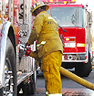
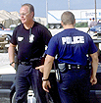
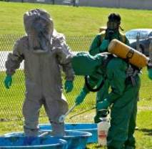
UNIFIED COMMAND BENIFITS
A shared understanding of priorities and restrictions.
A single set of incident objectives.
Collaborative strategies.
Improved internal and external
information flow.
Less duplication of efforts.
Better resource utilization.

Slide 78


UNIFIED COMMAND FEATURES
  A single integrated incident organization
  Co-located (shared) facilities
  One set of incident objectives, and one Incident Action Plan
  Integrated General Staff – Only one Operations Section
  Coordinated process for resource ordering

Slide 79
MAINTAINING SPAN OF CONTROL
Divisions
Divide an incident geographically.
Groups
Describe functional
areas of operation.
Branches
Used when the number of
Divisions or Groups exceeds the span of control. Can be either geographical or functional.
Notes:
Span of Control is the number of resources for which a supervisor is responsible, usually expressed as the ratio of supervisors to individuals. (Under NIMS, an appropriate span of control is between 1:3 and 1:7, with optimal being 1:5.)
The following supervisory levels can be added to help manage span of control:
Divisions. Divisions are used to divide an incident geographically. The person in charge of each Division is designated as a Supervisor.
Groups. Groups are used to describe functional areas of operation. The person in charge of each Group is designated as a Supervisor.
Branches. If the number of Divisions or Groups exceeds the span of control, it may be necessary to establish another level of organization within the Operations Section, called Branches. The person in charge of each Branch is designated as a Director

Slide 80
ORGANIZING RESOURCES
Single Resources may be individuals, a piece of equipment and its personnel complement, or a crew or team of individuals with an identified supervisor that can be used at an incident.
Single Resource
Strike Teams are a set number of resources of the same kind and type with common communications operating under the direct supervision of a Strike Team Leader.
Strike Team
Task Forces are a combination of mixed resources with common communications operating under the direct supervision of a Task Force Leader.
Task Force
Notes:
Single Resource.
Strike Teams. Typically no more than 5 to meet the span of control requirements. Example: 5 Engine Companies, 3 Truck Companies, etc.
Task Force. Again, typically no more than 5 resources. Example: 3 Engine Companies & 2 Truck Companies, 2 Engine Companies & 3 Tankers

Slide 81
REVIEW
Who has overall responsibility at an incident?
You are working at an incident in a remote area. A facility has been set up to provide you and other responders with water, food, and areas to nap. What is the ICS term for this facility?
You need to copy some maps and submit an order for supplies. What incident facility would you go to?
______ is an orderly line of authority within the ranks of the organization, with lower levels subordinate to, and connected to, higher levels.
You need to deliver something to the Incident Commander. What is the name of the location from which the Incident Commander oversees incident operations?
_______ pertains to the number of individuals or resources that one supervisor can manage effectively during an incident.
Notes:
ANSWERS
Incident Commander
Camp
Base
Chain of Command
Incident Command Post
Span of Control

Slide 82
Personnel Accountability

Slide 83
Personnel Accountability
Provide Safety For FD Personnel Operating on Incidents
System for Tracking Personnel In Operational Areas
Allows Rapid Accountability for Evacuation and Search

Slide 84
Implementation
Implemented upon the arrival of the first unit
Continues until the IC determines that it is no longer necessary
Governed by Fairfax County SOP and Operations Manual

Slide 85
Passport Name Tags
Layout: First Line - first initial and last name
Second Line - Jurisdiction identification and rank
Symbol: to the right for all ALS providers
Colors:
White/Black Letters
  Any officer who is certified to enter an IDLH environment.
Yellow/Black Letters –
  Any member (F/F, D/O, Tech, etc.) who is certified to enter an IDLH environment.
Blue/White Letters –
  EMS-certified personnel, includes EMS officers who are not certified to enter an IDLH environment.
Red/White Letters
  Members who are not certified EMS, fire, or are not certified to enter an IDLH environment (recruits, red hats, etc.).
Notes:
Currently
White-Suppression Officers
Blue - ALS Personnel
Yellow - Technicians and FF (Minimum)
Red - Not Yet Firefighter Trained
Orange - EMS Only
Slide der=tails are from July 1, 2006 and apply to all NOVA jurisdictions

Slide 86
Jurisdiction Identifications:
AFD - Alexandria City Fire Department
ACFD - Arlington County Fire Department
FCTY - Fairfax City Fire Department
FXCO - Fairfax County Fire Department
FBFD - Fort Belvoir Fire Department
FMFD - Fort Myer Fire Department
LCFR - Loudoun County Fire Rescue
MWAA - Metropolitan Washington Airport Authority Fire Department
FBEMS - Fort Belvoir EMS
PWC - Prince William County Fire Rescue
MVFC - City of Manassas Fire Department
MVRS - Manassas Rescue Squad
MPFD - Manassas Park Fire Department
  Italics indicate non-signatory NOVA jurisdictions.

Slide 87
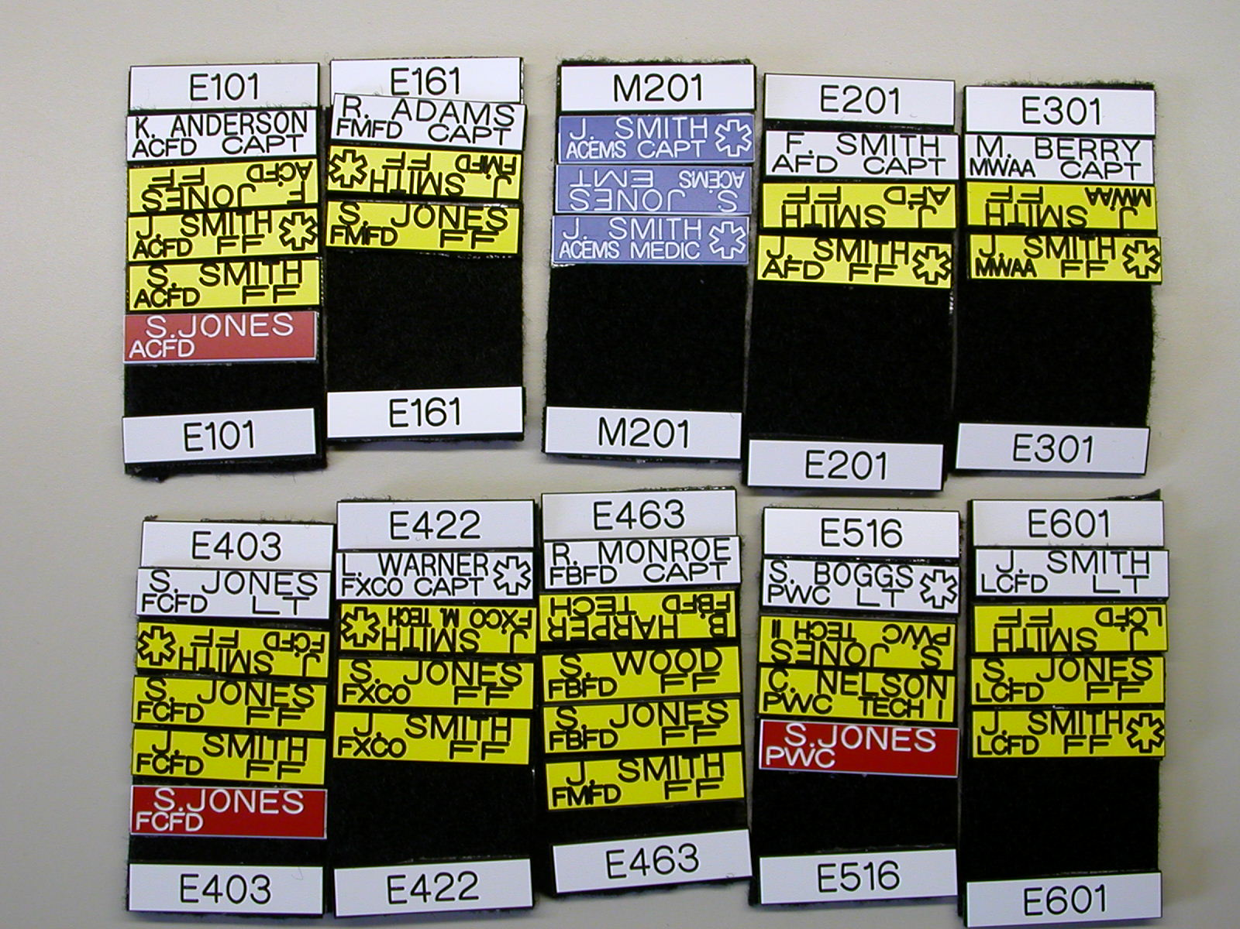

Slide 88
How It Works
1 Passport, 1 Roster, and 1 Riding Card Per Unit
Member places name tag on passport, roster, & riding card
Place unit designator on helmet
Personnel not in hazard area are placed upside down (driver)
Upon arrival on scene, officer leaves passport at drop-off or command post
Riding Card is kept by the officer
Notes:
Riding card is to be carried in the officer’s turnout coat radio pocket.
Riding Card is a duplicate of the passport and is held by the officer at all times – vital when working with personnel not normally assigned to his crew. Valuable tool for Volunteer Unit Officers working with personnel from other volunteer stations.

Slide 89
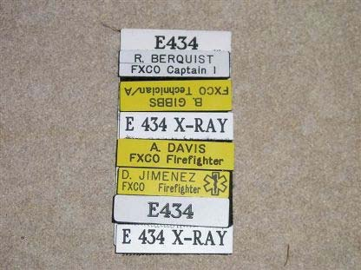
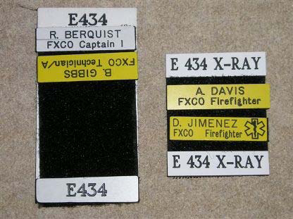
X-Ray Passports
The X-Ray passports will allow the incident commander to have more teams should staffing and the task required dictate such a need. Command alone will make the determination on the use of an X-Ray team.
For example, the second team from Engine 434 shall be called Engine 434X-Ray.
If command decides to split a team, extra caution should be taken into account and factors such as experience and the task at hand should be considered.
Notes:
Standing order 2007-008

Slide 90
Apparatus Unit Identifiers
When a single station has two or more units of the same type assigned to it, a suffix is added to the unit identifier to uniquely designate each unit from a station. The suffix of the first unit, the alpha unit (i.e., E403-A) is silent and shall not be transmitted. All subsequent units shall transmit their designator with the suffix.
  The first ambulance assigned to Station 421 (Ambulance 421) is identified as A421 – spoken as “Ambulance Four-Twenty-One.”
  The second ambulance from Station 421 is identified as A421B – spoken as “Ambulance Four-Twenty-One-Bravo.”
Notes:
GENERAL ORDER 2007-090 November 21, 2007 PAGE 4 OF 4
The officer-in-charge of additional EMS-only units that are placed in service in the same station shall contact the Uniformed Fire Officer at the Department of Public Safety Communications for their designator. The designator will be assigned according to the station they will be relocated to.
For example:
Fire Station 22 has two EMS-only ambulances in service. The second ambulance would be relocated to Fire Station 26 and be given the designator and suffix A426E.
MAKE SURE YOU HAVE THE CORRECT PAASPORT WHEN YOU STAFF YOUR UNIT

Slide 91
Apparatus Unit Identifiers
For EMS-Only Transport Units:
When an EMS-only ambulance or medic unit is staffed, it shall use the “E” suffix.
  A422 is staffed with an EMS-only crew. A422 now is identified as A422E – spoken as “Ambulance Four-Twenty-Two-Echo.”
  If one of the crew is an EMT, and the other is a FF/EMT, the unit is classified as EMS Only
Notes:
GENERAL ORDER 2007-090 November 21, 2007 PAGE 4 OF 4
The officer-in-charge of additional EMS-only units that are placed in service in the same station shall contact the Uniformed Fire Officer at the Department of Public Safety Communications for their designator. The designator will be assigned according to the station they will be relocated to.
For example:
Fire Station 22 has two EMS-only ambulances in service. The second ambulance would be relocated to Fire Station 26 and be given the designator and suffix A426E.
MAKE SURE YOU HAVE THE CORRECT PAASPORT WHEN YOU STAFF YOUR UNIT

Slide 92

Notes:
Note:

Slide 93
Helmet ID Unit Designators
Engine Companies
  Officers= White inserts with red numerals
  Other positions= Red inserts with white numerals
Truck Companies
  Officers= White inserts with green numerals
  Other positions= Green inserts with white numerals
Rescue Companies
  Officers= White inserts with black numerals
  Other positions= Black inserts with white numerals
EMS Units
  Officers= White inserts with blue numerals
  Other positions= Blue inserts with white numerals
    Ambulances will have only blue inserts (no officer insert)
Foam Units
  Officers= White inserts with orange numerals
  Other positions= Orange inserts with white numerals
Battalion Chiefs
  Officers= White inserts with gold numerals
Auxiliary units or Staff Positions
  Officers= White inserts with yellow numerals
  Other positions= Yellow inserts with white numerals

Slide 94
Shield
LIEUTENANT
FIREFIGHTER
410
410
E430
E430
Front Inserts
FAIRFAX
COUNTY
FAIRFAX
COUNTY
Helmet Color
Side Inserts
E410
E410
COUNTY
Tetrahedron Color

Slide 95
BATTALION
DEPUTY
ASSISTANT
CHIEF
CHIEF
CHIEF
CHIEF
402
COFFMAN
ROHR
MASTIN
FAIRFAX COUNTY
Fairfax County
Fairfax County
Fairfax County
LIEUTENANT
LIEUTENANT
CAPTAIN
LIEUTENANT
CAPTAIN
E410
410
410
410
E430
E430
E430
E430
FAIRFAX
FAIRFAX
COUNTY
COUNTY
FAIRFAX
COUNTY
FAIRFAX
COUNTY
PROBATIONARY
FIREFIGHTER
FIRE MEDIC
TECHNICIAN
MASTER
410
410
410
410
410
FAIRFAX
COUNTY
FAIRFAX
COUNTY
FAIRFAX
COUNTY
FAIRFAX
COUNTY
FAIRFAX
COUNTY

Slide 96
E410
E410
E410
E410
BFC/DFC/AFC/FC
(BFC will have Side Identifiers)
LT/CPT/CPT II
VUO
PROB/FM/
FF/TECH/MTECH

Slide 97
E410
E410
ALL Personnel
(Below the rank of DFC)
Side Identifiers
Same Size as Tetrahedron
ALL Personnel
U.S. Flag
2” x 1 1/2”

Slide 98
FIREFIGHTER
LIEUTENANT
LIEUTENANT
Engine Company
430
E410
430
E430
E430
FIREFIGHTER
LIEUTENANT
FAIRFAX
COUNTY
FAIRFAX
LIEUTENANT
FAIRFAX
COUNTY
430
COUNTY
Truck Company
E410
430
E430
E430
FIREFIGHTER
LIEUTENANT
FAIRFAX
COUNTY
FAIRFAX
LIEUTENANT
FAIRFAX
COUNTY
418
COUNTY
Rescue Company
E410
418
E430
E430
FIREFIGHTER
LIEUTENANT
FAIRFAX
COUNTY
FAIRFAX
LIEUTENANT
FAIRFAX
COUNTY
402
COUNTY
EMS Unit
E410
402
E430
E430
FIREFIGHTER
BATTALION
LIEUTENANT
FAIRFAX
COUNTY
LIEUTENANT
FAIRFAX
CHIEF
FAIRFAX
COUNTY
402
COUNTY
Battalion Chief (and Aide)
402
E410
402
E430
E430
FIREFIGHTER
LIEUTENANT
FAIRFAX
COUNTY
FAIRFAX COUNTY
LIEUTENANT
FAIRFAX
FAIRFAX
COUNTY
437
COUNTY
Foam Unit
E410
437
E430
E430
FIREFIGHTER
LIEUTENANT
FAIRFAX
COUNTY
FAIRFAX
LIEUTENANT
FAIRFAX
COUNTY
FRA
COUNTY
Auxiliary Units
E410
FRA
E430
E430
FAIRFAX
COUNTY
FAIRFAX
FAIRFAX
COUNTY
COUNTY

Slide 99
What is this?
TECHNICIAN
LIEUTENANT
LIEUTENANT
430
E410
430
E430
E430
E430
E430
FAIRFAX
COUNTY
FAIRFAX
FAIRFAX
COUNTY
COUNTY
Driver
Officer
TECHNICIAN
FIREFIGHTER
430
430
E430
E430
FAIRFAX
COUNTY
FAIRFAX
COUNTY
Medic
Firefighter
Notes:
Engine Company

Slide 100
What is this?
TECHNICIAN
LIEUTENANT
LIEUTENANT
430
E410
430
E430
E430
E430
E430
FAIRFAX
COUNTY
FAIRFAX
FAIRFAX
COUNTY
COUNTY
Driver
Officer
TECHNICIAN
FIREFIGHTER
430
430
E430
E430
FAIRFAX
COUNTY
FAIRFAX
COUNTY
Medic
Firefighter
(with Probationary member as the firefighter)
Notes:
Engine company with Probationary FF riding as Minimum Staffing

Slide 101
What is this?
TECHNICIAN
LIEUTENANT
LIEUTENANT
410
E410
410
E430
T410
E430
T410
FAIRFAX
COUNTY
FAIRFAX
FAIRFAX
COUNTY
COUNTY
Driver
Officer
FIREFIGHTER
410
T410
FAIRFAX
COUNTY
Firefighter
Notes:
Truck Company

Slide 102
What is this
TECHNICIAN
LIEUTENANT
LIEUTENANT
402
E410
402
E430
M402
E430
M402
FAIRFAX
COUNTY
FAIRFAX
FAIRFAX
COUNTY
COUNTY
Driver
Officer
Notes:
Medic unit

Slide 103
Incident Operations
First arriving unit takes or passes command
Designates Passport Drop
Command Officer places rosters on command board
Remote Entry-At first unit at remote location (mall, distant side, etc.)
Alert Tone
  Entry Control
  Evacuation
  Red Hats To Report to IC

Slide 104
Incident Operations
DPSC - 10 minute marks until situation stable
Roll Call at 20 minute mark
  Initiated by IC
  All sectors to account for personnel
  Report “PAR” when called by IC
  All sectors will be checked
Confirmation to DPSC

Slide 105
Incident Operations
All personnel must have name tags
Minimum operating crews or teams of two
Operating crews must have a portable radio
Enter and exit areas together
Maintain voice or other contact
Each team member must be able to:
  Provide direct help to team members
  Call for assistance
  Go and get help for a team member that is injured

Slide 106
Where are you? - Sides/Quadrants
Side C
Division C
Side B
Side D
B quadrant
C quadrant
Division B
E Quadrant
Division D
A quadrant
D quadrant
Side A
Structure with Quadrants
Division A

Slide 107
Where are you? - Multi Story
Division 5
Fifth Floor
Division 4
Fourth Floor
Division 3
Third Floor
Division 2
Second Floor
Division 1
First Floor
Sub-Floors
Examples: Basement, Mezzanine, P1, P2, L1, L2
** Sub-floors will be designated as the actual name of the sub-floor

Slide 108
Where are you? - Exposures
Exposure C
Exposure B
Fire Building
Exposure B
Exposure D
Address Side
Exposure A

Slide 109
Where are you? - Exposures
B3
B2
B1
Fire Area
D1
D2
D3
Exposure B
You May Refer to Entire Area

Slide 110
Mayday!
The term “MAYDAY” will be used by personnel that are in immediate danger and in need of assistance
Rapid Intervention Teams (RIT) shall be established in accordance with the Standard Operating Procedures of the authority having jurisdiction

Slide 111
Summary: Accountability System
Operate in teams of at least two
Have method of communications
Regular Status Reports to IC
Immediately report injured or missing member
Required for SCBA incidents or discretion of IC
Name Tags
Helmet ID designators
Placement on passport, rosters, & riding cards

Slide 112
At each level of the ICS organization, individuals with primary responsibilities have distinct titles.
To survive on the fire scene,
firefighters / EMTs
must know the roles and responsibilities
of the personnel,
how the command structure works,
and be part of that command structure

Slide 113
National Incident Management System (NIMS)
On-Line Training
As each course provides the foundation for the next course, do in following order
  IS-700.a—ICS for Single Resources and Initial Action Incidents http://training.fema.gov/EMIWeb/IS/is700a.asp
  IS-100.b—Introduction to Incident Command System http://training.fema.gov/EMIWeb/IS/IS100b.asp
  IS-200.b—ICS for Single Resources and Initial Action Incidents
  http://training.fema.gov/EMIWeb/IS/IS200b.asp
  IS-800.b—An Introduction to National Response Framework
  http://training.fema.gov/EMIWeb/IS/IS800b.asp
All are pre-requisites for EMT School or before you can ride as an EMT if already have certification.
On completion of each course you will be given a link to print out your certificate.
  Either forward that link to VTC and your VFD Training Officer
  Or print and send copy to VTC and your VFD Training Officer
Notes:
Directions to take course are on the CD

Slide 114

Finished

