Slide 1
FIREFIGHTER’S OATH
“I do solemnly swear that I will support and uphold the Constitution of the United States of America, the Constitution of the Commonwealth of Virginia, and the Regulations of the Fairfax County Fire and Rescue Department, that I will protect the lives and property of the citizens of Fairfax County, that I will discharge my duties as a firefighter to the best of my ability, and I will maintain the highest standard of integrity in my chosen profession, so help me God.”

Slide 2
History, Organization, and Terminology

Slide 3
Goals
To provide an overview of Fairfax County
To become familiar with the organization of Fairfax County Fire and Rescue Department and Volunteer Organizations..
Understand the Volunteer Utilization Plan and your role in it.

Slide 4
Objectives
Learn the ranks used within the Fairfax County Fire and Rescue Department and the volunteer operational ranks
Learn a basic suppression & EMS vocabulary to increase communication skills between fellow firefighters and instructors.
Learn the organizational chart and responsibilities of the divisions.

Slide 5
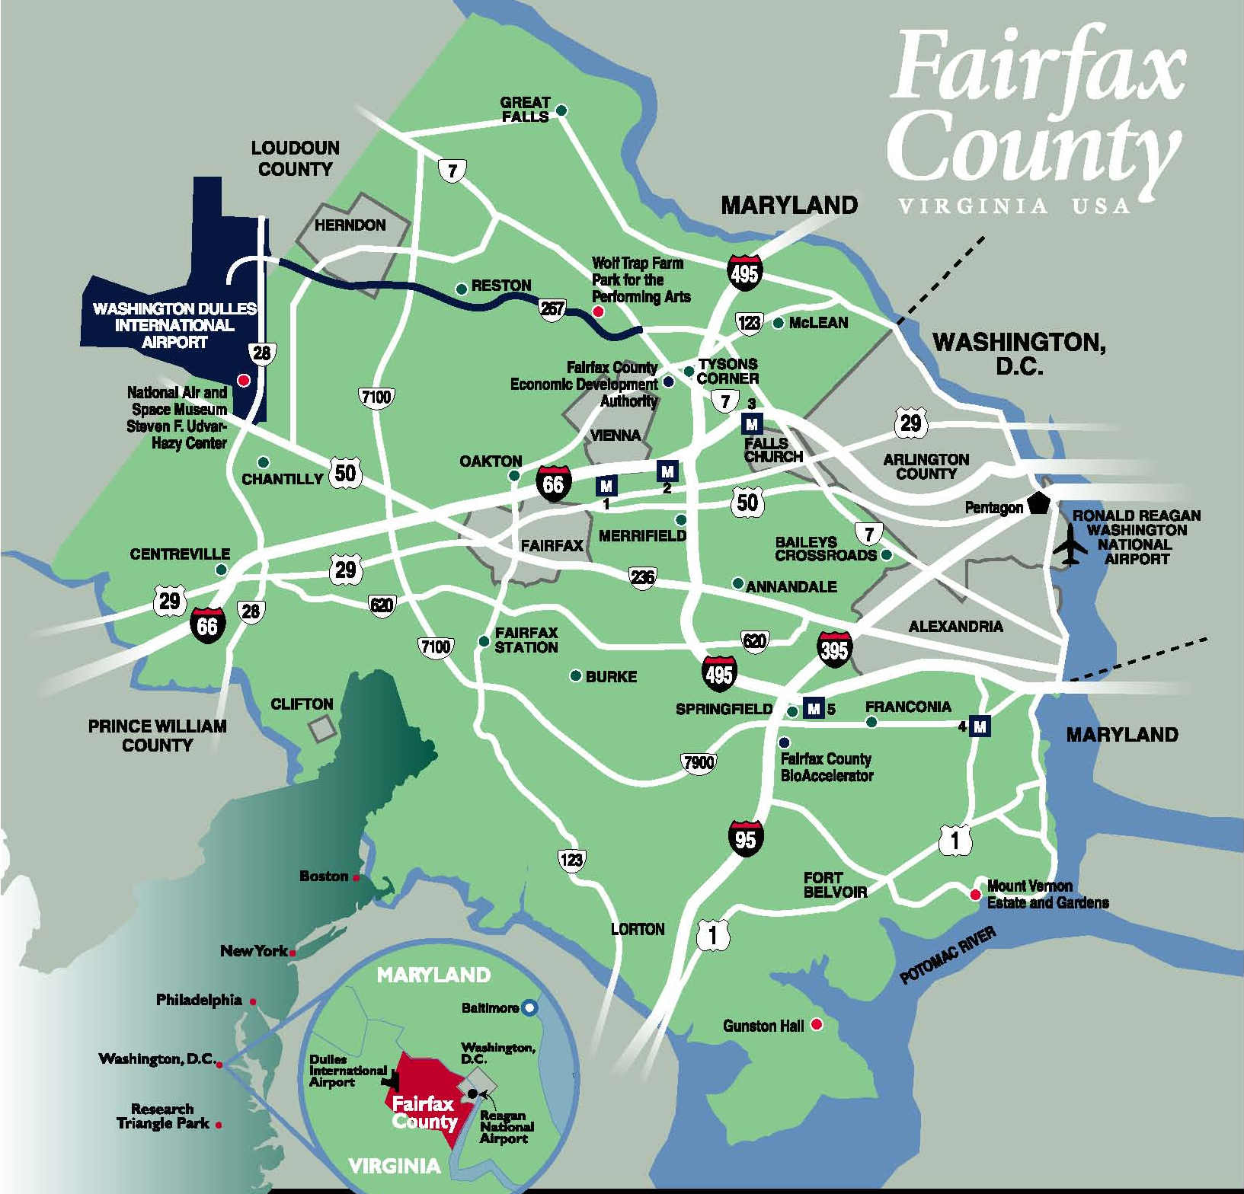

Slide 6
Core Purpose of Fairfax County Government
To protect and enrich the quality of life for the people, neighborhoods, and diverse communities of Fairfax County.

Slide 7
Our Community
Fairfax County established in 1742
Evolved from a rural community to become the largest jurisdiction in the National Capital Region
Land Area - 395 Square miles
Roads - 4,800 miles
Population (2009) = 1,051,990
4.9 % live below the poverty line
32.9% speak a language other than English at home (over 100 languages spoken in FCPS)
5.4% unemployed

Slide 8
FxCo Government
Fairfax County operates under the urban county executive form of government, an optional form of Virginia county government, and like other Virginia local governments, Fairfax County has limited powers.
The powers of government are vested in an elected Board of Supervisors consisting of nine members elected by district, plus a Chairman elected at large.
The Board appoints the County Executive, who is the administrative head of the county government and is responsible for the administration of all of the affairs of the county which the Board has authority to control.

Slide 9
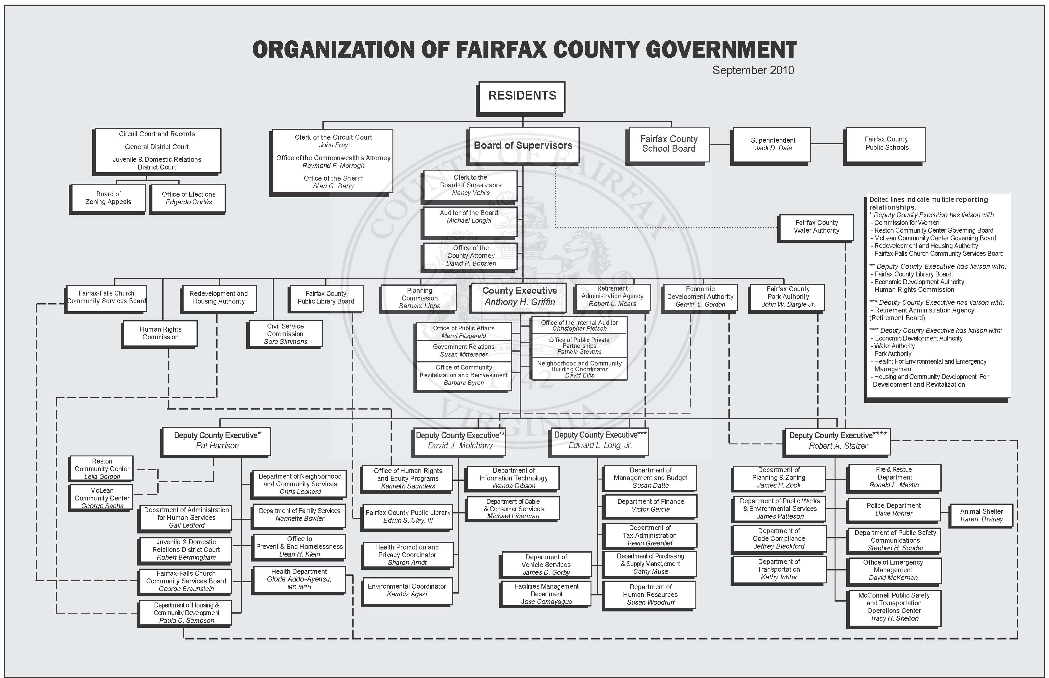

Slide 10
Fairfax County Code of Ethics
I. Honesty: Be truthful in all endeavors
II. Public Service: Ensure all actions taken and decisions made are in the best interest of the general public.
III. Respect: Treat all individuals with dignity; be fair and impartial;
IV. Responsibility: Take responsibility for actions
V. Stewardship: Exercise financial discipline with assets and resources
VI. Trust: Build regard for one another through teamwork and open communication
YOU are bound by these ethics while operating as a volunteer within the County
Notes:
Fairfax County Code of Ethics
Fairfax County Code of Ethics is intended to inspire a superior level of conduct, sensitivity and sound judgment for all employees. (1) The code is intended to complement, not replace all professional codes of ethics. Employees should be aware of and abide by their respective professional values and requirements. All employees must perform their designated function in a manner that reflects the highest standards of ethical behavior. All employees are obligated to respect, honor and uphold the Constitution, laws and legal regulations, policies and procedures of the United States, the Commonwealth of Virginia, and the County of Fairfax.
The code of ethics is supported by six core principles that form the ethical foundation of the organization: Honesty, Public Service, Respect, Responsibility, Stewardship and Trust.
I. Honesty: Be truthful in all endeavors; be honest and forthright with each other and the general public.
II. Public Service: Ensure all actions taken and decisions made are in the best interest of the general public.
III. Respect: Treat all individuals with dignity; be fair and impartial; affirm the value of diversity in the workplace and in Fairfax County; appreciate the uniqueness of each individual; create a work environment that enables all individuals to perform to the best of their abilities.
IV. Responsibility: Take responsibility for actions; work a full day; conduct all workplace actions with impartiality and fairness; report concerns in the workplace, including violations of laws, policies and procedures; seek clarification when in doubt; ensure that all decisions are unbiased.
V. Stewardship: Exercise financial discipline with assets and resources; make accurate, clear and timely disclosures to the public; maintain accurate and complete records; demonstrate commitment to protecting entrusted resources.
VI. Trust: Build regard for one another through teamwork and open communication; develop confidence with the public by fulfilling commitments and delivering on promises.
(1) For the purpose of this document, the term employees includes all personnel, volunteers and all elected and appointed officials working on behalf of Fairfax County.

Slide 11
Fire & Rescue Department’s Vision
Dedicated to being the best community-focused fire and rescue department ensuring a safe and secure environment for all.
Notes:
BY
Maintaining a leadership role in local, state, and national pub safety initiatives. -
Developing, implementing, and maintaining innovative prevention programs and strategies, life safety education, and training for our community.
Maintaining the highest departmental readiness to provide emergency medical and fire suppression services.
Maintaining state-of-the-art special operations capabilities.
Seeking new and better ways to further integrate the Fire and Rescue Department into our communities.
Conducting research and using technology to enhance the achievement of these objectives

Slide 12
Mission Statement
Provides the highest quality services to protect the lives, property, and environment to our community
Notes:
Mission Statement Achieved through Strategic objectives”
Develop and deliver the highest quality of “all –hazards’ service delivery
Be a leader in local, state and national public safety initiatives
Ensuring workforce readiness and leadership through innovative education and training programs
Ensure workforce health and safety
Reflect the Community we serve with a diverse work force
Increase organizational effectiveness

Slide 13
Department Motto
Proudly Protecting and Serving
Our Community

Slide 14
Core Values
Professional Excellence
Health & Safety
Diversity
Teamwork & Shared Leadership
Effective Communication
Integrity
Community Service & Involvement
Innovation
Notes:
Professional Excellence
We believe the pursuit of excellence and demonstrating high professional standards are critical to our work. . To ensure the best possible service for our community, the Fire and Rescue Department supports continuous training and encourages professional development.
Health and Safety
We believe our health and safety are essential to fulfilling the Fire and Rescue Department's mission. We are committed to providing the best health and safety programs for our members' well-being and operational readiness.
Diversity
We know Fairfax County is a diverse community, and we commit to meeting its ever-changing needs. We are dedicated to reflecting and respecting that diversity throughout our organization. We will respect the diversity of our community by providing compassionate and quality service to all.
Teamwork and Shared Leadership
We know well-functioning teams of people are more effective than individuals working separately; our lives depend on it. We believe individuals have the capacity to lead, and our organization values leadership at all levels. Teamwork and shared leadership are integral to our organization, and we will seek out and value the opinions of our members.
Effective Communication
We believe communication is essential to the cohesiveness and performance of our organization. We are committed to providing effective and responsive means of communication throughout the organization and the community.
Integrity
We understand the trust placed in us by the public and our colleagues is integral to the performance of our duties. We are committed to honest and ethical behavior, and we will hold ourselves accountable to these values.
Community Service and Involvement
We believe we have a duty to be involved in the communities where we work. Our responsibility is to protect life, property, and the environment. We are committed to fulfilling our responsibility and to deepening our involvement in the community we serve. No request or inquiry will go unanswered.
Innovation
We recognize and understand that the constancy of change in our community and industry impacts our business daily. We are committed to seeking out and implementing innovative and progressive thinking to address change effectively to benefit those we serve.

Slide 15
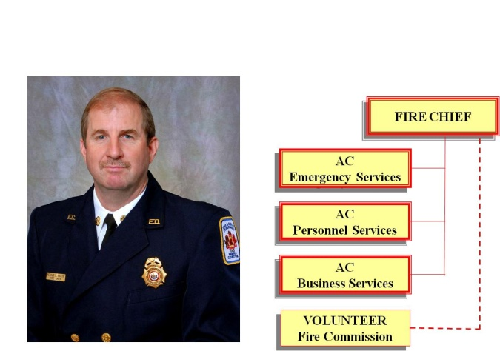
Fire And EMS Service Organizational Structure
Board of Supervisors
County Executive
Deputy County Exec
Fire Chief
Volunteer Fire Commission
FCVFRA
Volunteer Liaison
Volunteer Companies
Volunteer Training Coordinator
Operations and
Management Policies
Operational Direction
Operations Committee
Training Committee
Functional Representatives
Notes:
The Board of Supervisors has overall responsibility for the delivery of Fire and EMS services within Fairfax County.
The Fire Chief manages the operational delivery of the Fire and EMS service, and administers the paid personnel in the Fairfax County Fire and Rescue Department
The Fire Chief reports to the BoS through the Deputy County Executive (Public Safety) and County Executive
The Volunteer Fire Commission is the communication point for Fire and EMS operating procedures and policies between the Fire Chief and Volunteer Companies
The Fairfax County Volunteer Fire and Rescue Association is the communication point for volunteer operational and administrative management members to coordinate operations, training and administration
FCVFRA committees and functional representatives (communications, apparatus, etc) provide person-to-person communication between the volunteer system and the FRD
The Volunteer Liaison administers the volunteer component of the FRD budget within its organizational structure
The Volunteer Training Coordinator manages the formal training and qualification programme for volunteer personnel within the FRD’s Training Division
15

Slide 16
Fairfax Fire & Rescue Department Overview
37 stations
7 Battalions
1,381 Uniformed
141 Civilians, full-time
119 Civilian, seasonal
311 Operational Volunteers (as of 12/29/1010)
142 volunteers in training (as of 12/29/10)
230 Administrative Volunteers (as of 12/29/10)
37 Advanced Support Engines
38 Medics
4 Ambulances
2 Haz Mat unit
7 Aerial ladders
7 Tower ladders
8 Rescues
5 Tankers

Slide 17
Chief Ronald L. Mastin Fire Chief
FIRE CHIEF
AC
Operations Bureau
AC
Personnel Services Bureau
AC
Business Services Bureau
Volunteer
Fire Commission

Slide 18
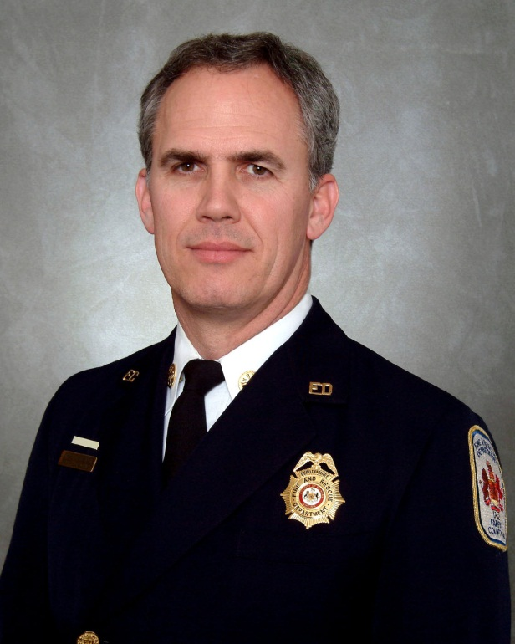
Operations Bureau
AC
John Caussin
Ops A-Shift
DC Walsh
Ops B-Shift
DC Ryan
Ops C-Shift
DC Duke
EMS Admin
DC Morrison
Special Services
DC Johnson
Notes:
DC Special Services no longer exists

Slide 19
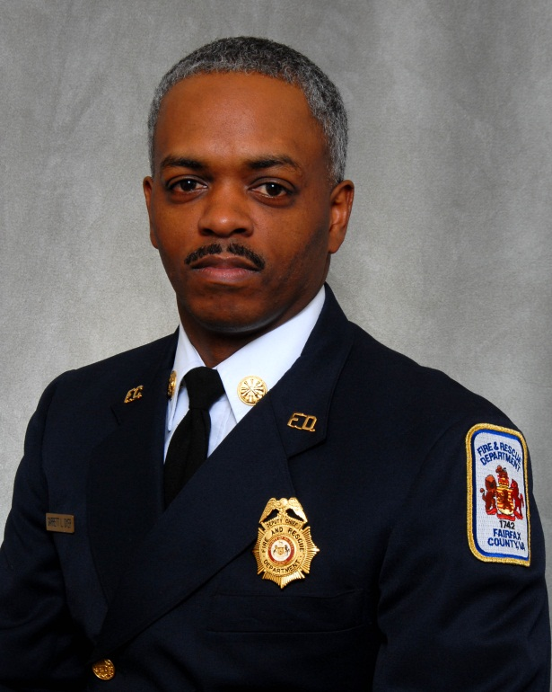
Personnel Services Bureau
AC
Dyer
Safety & Personnel Services
DC Diamantes
Training Division
DC Reilly
Volunteers *
Jeffrey Katz
EEO & Women’s Program *
Catharine Riley-Hall
Professional standards
Guy Morgan
Notes:
* Have direct line to Fire Chief for certain issues

Slide 20
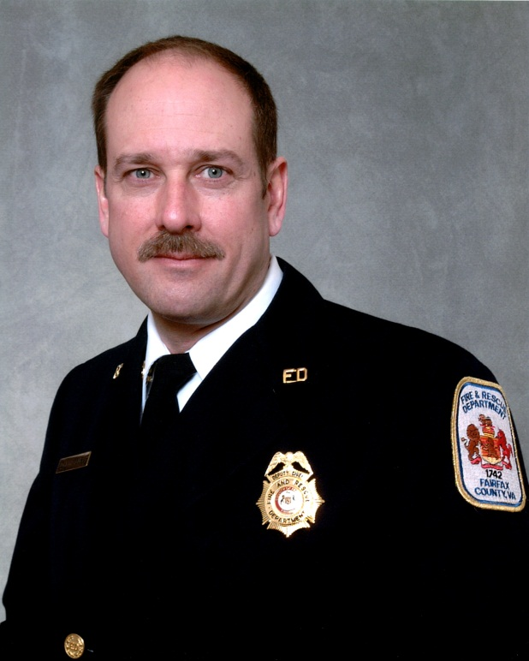
Business Services Bureau
AC
John Burke
Prevention
DC Baker
Planning
Laurel Stone
Public Affairs& Life Safety Education
Dan Schmidt*
Support Services
DC Dodwell
Fiscal Services
Cathi Schultz-Rinehart
Notes:
Has direct access to Fire Chief

Slide 21
Incidents
EMS 65,898 
Suppression 18,076 
Special Operations 1,344 
Public Service 6,520 
Total 91,838 
(Average of 252 per day)
Patients Transported 47,228 
Response Statistics (July 09 – June 10)
Notes:
Symbol denotes from previous year
Vehicle Responses : Suppression = 112,059, EMS Units = 82,298, Staff/Support Units = 932

Slide 22
Trends
Notes:
In FY 2010
65,898 EMS
18,076 Suppression
Total Responses = 91,838
= 72% EMS of Total calls

Slide 23
Shift Operations
County operates a three shift schedule (A, B, and C shifts)
Provides coverage of “front line” units 24 hours a day
Shift change at 0700, runs 24 hours per shift
Shift staffing varies among stations, dependent upon minimum manning requirements for front line units assigned to station

Slide 24
Fairfax County Fire and Rescue Stations
1 McLean
2 Vienna
4 Herndon
5 Franconia
8 Annandale
9 Mt. Vernon
10 Bailey’s X-Roads
11 Penn Daw
12 Great Falls
13 Dunn Loring
14 Burke
15 Chantilly
16 Clifton
17 Centreville
18 Jefferson
19 Lorton
20 Gunston
21 Fair Oaks
22 Springfield
23 West Annandale
24 Woodlawn
25 Reston
26 Edsal Road
27 W. Springfield
28 Seven Corners
29 Tyson’s Corner
30 Merrifield
31 Fox Mill
32 Fairview
34 Oakton
35 Pohick
36 Frying Pan
37 Kingstowne
38 W. Centreville
39 North Point
40 Fairfax Center
41 Crosspointe
42 Beulah Road
Notes:
Yellow – Volunteer house owned by County
Dark Green – Volunteer house owned by Volunteers
Light Green –
23 owned by Annandale VFD
37 supported by Franconia with apparatus
38 supported by Centreville with apparatus
Dark Red – County Station
Black – proposed station

Slide 25
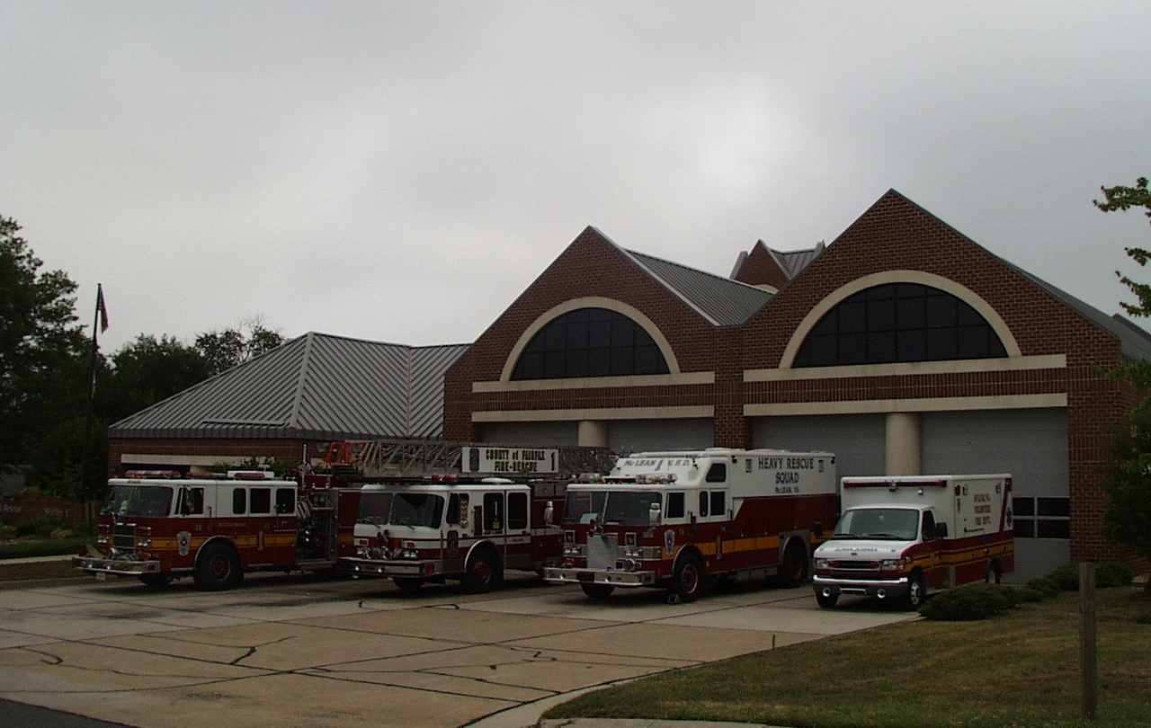
McLean (401)
Notes:
Station owned by the County

Slide 26
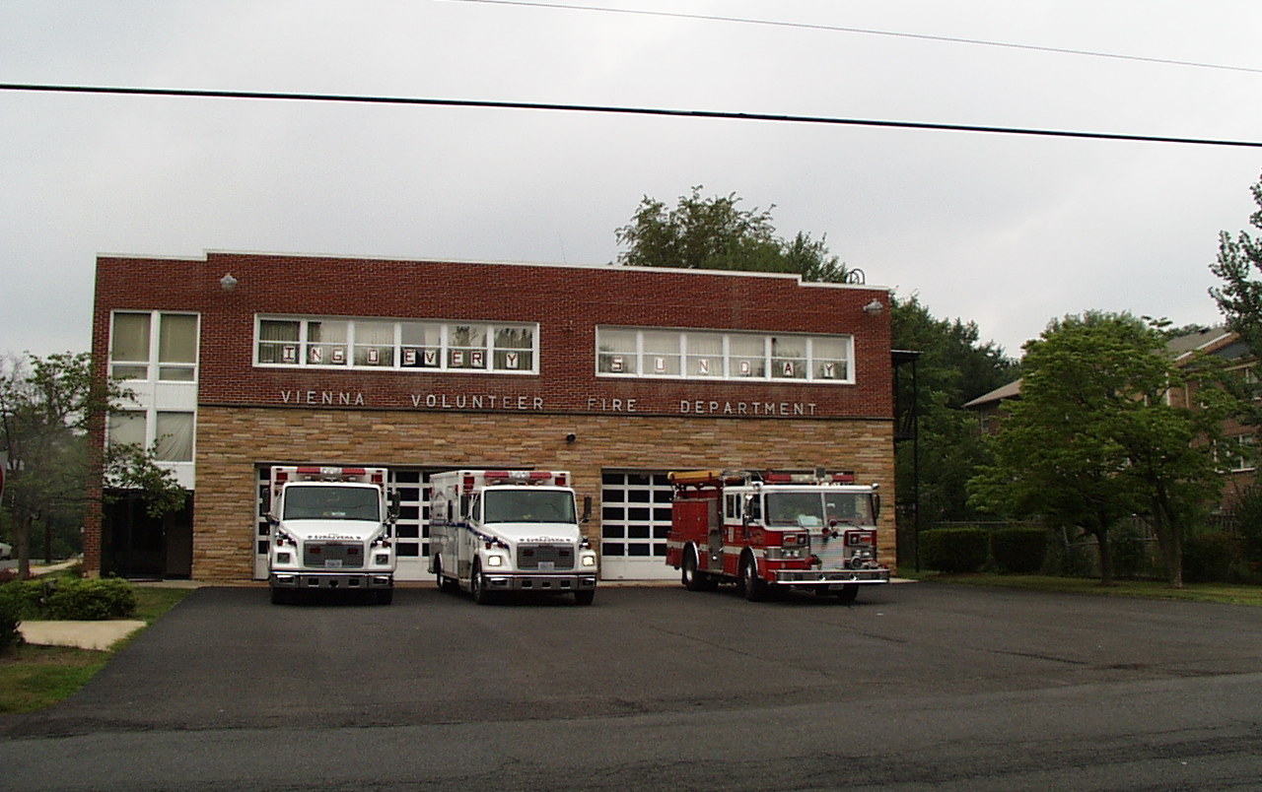
Vienna (402)

Slide 27
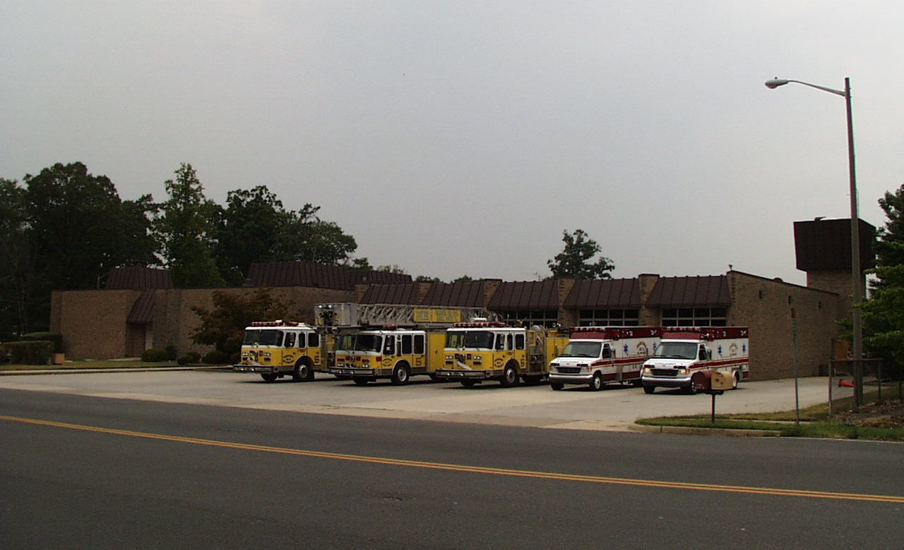
Franconia (405)

Slide 28
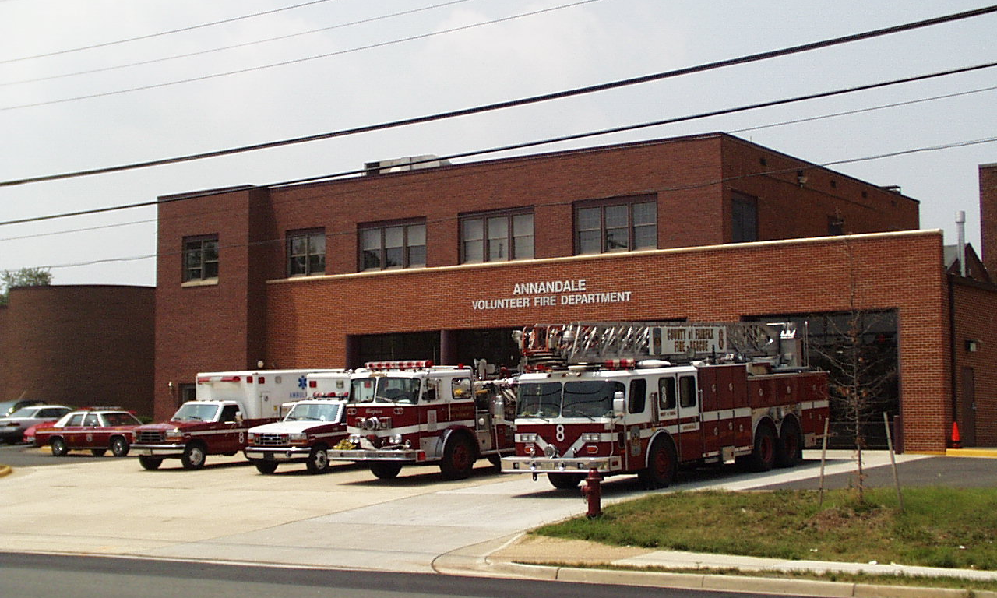
Annandale (408)

Slide 29
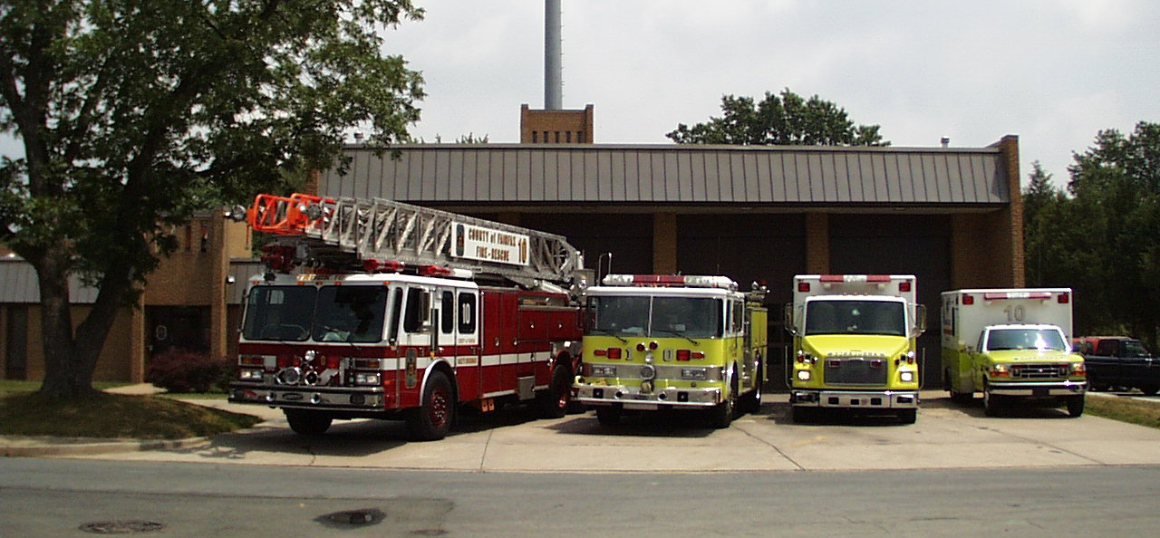
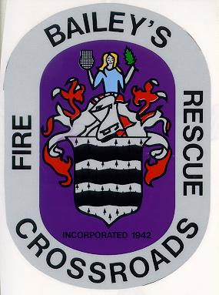
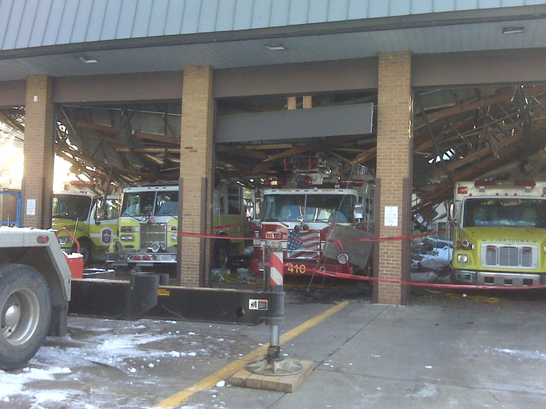
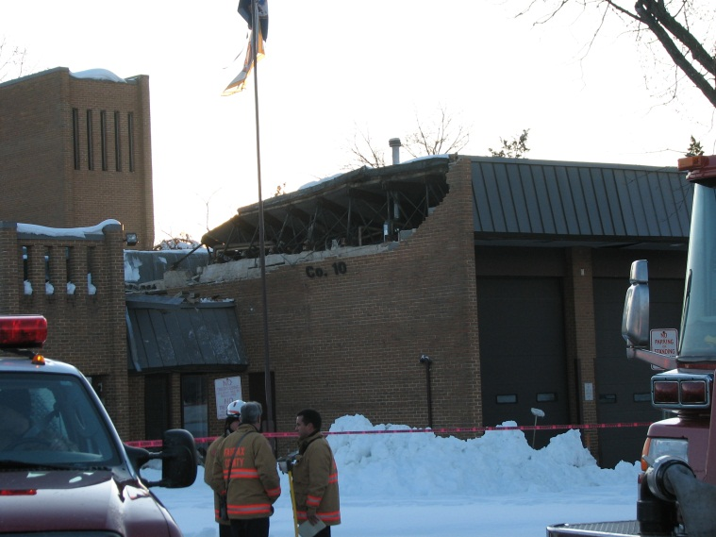
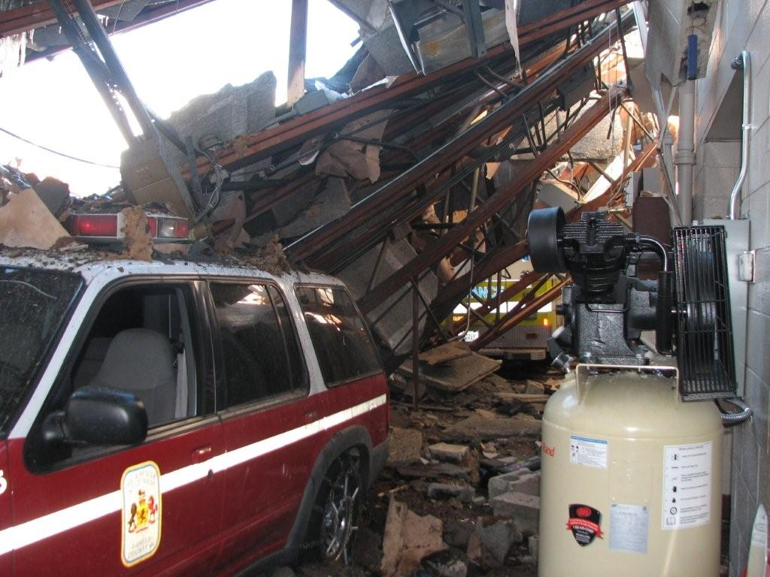
Bailey’s Crossroads (410)
Before the snow event of 2010
Notes:
New station in design phase – will be owned by the County

Slide 30
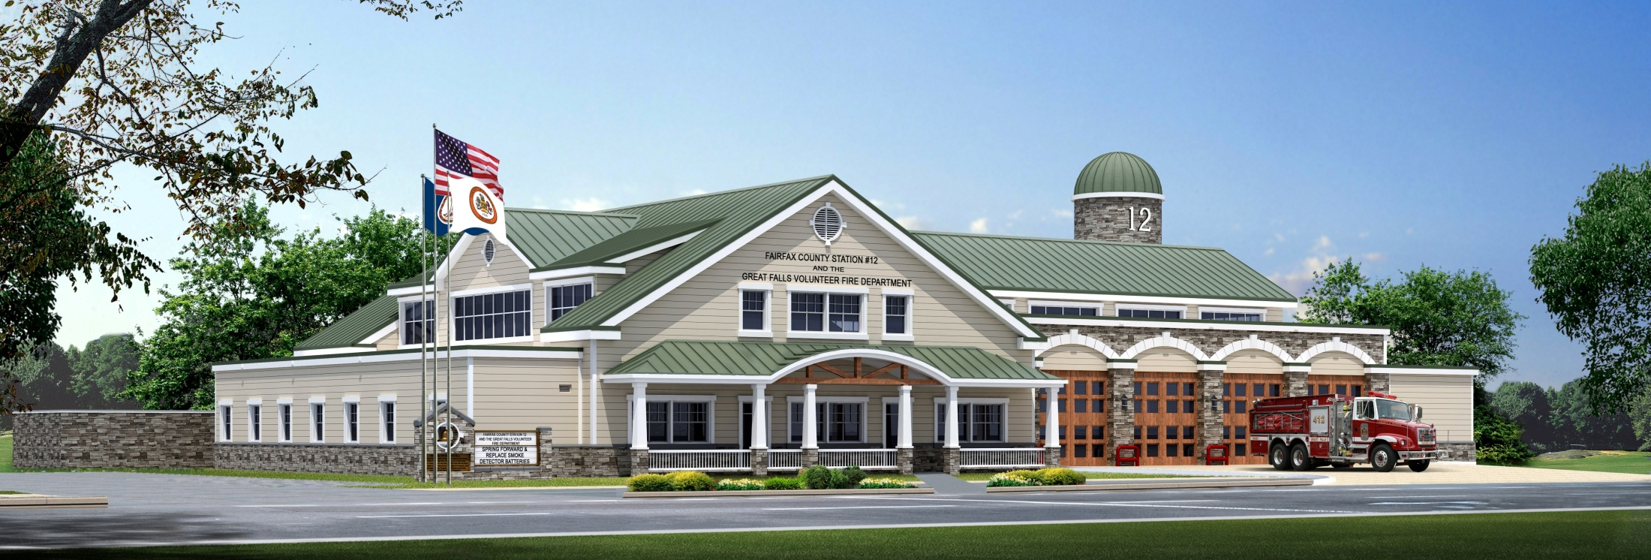
Great Falls (412)
(Station currently being re-built)
Notes:
Artists impression of the new station, will be owned by the County

Slide 31
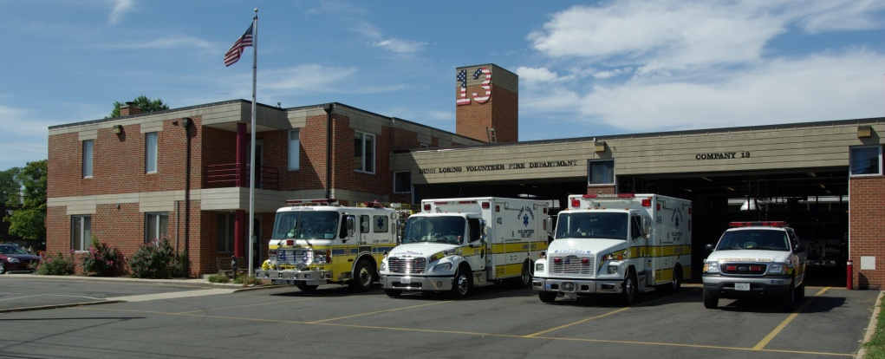
Dunn Loring (413)

Slide 32
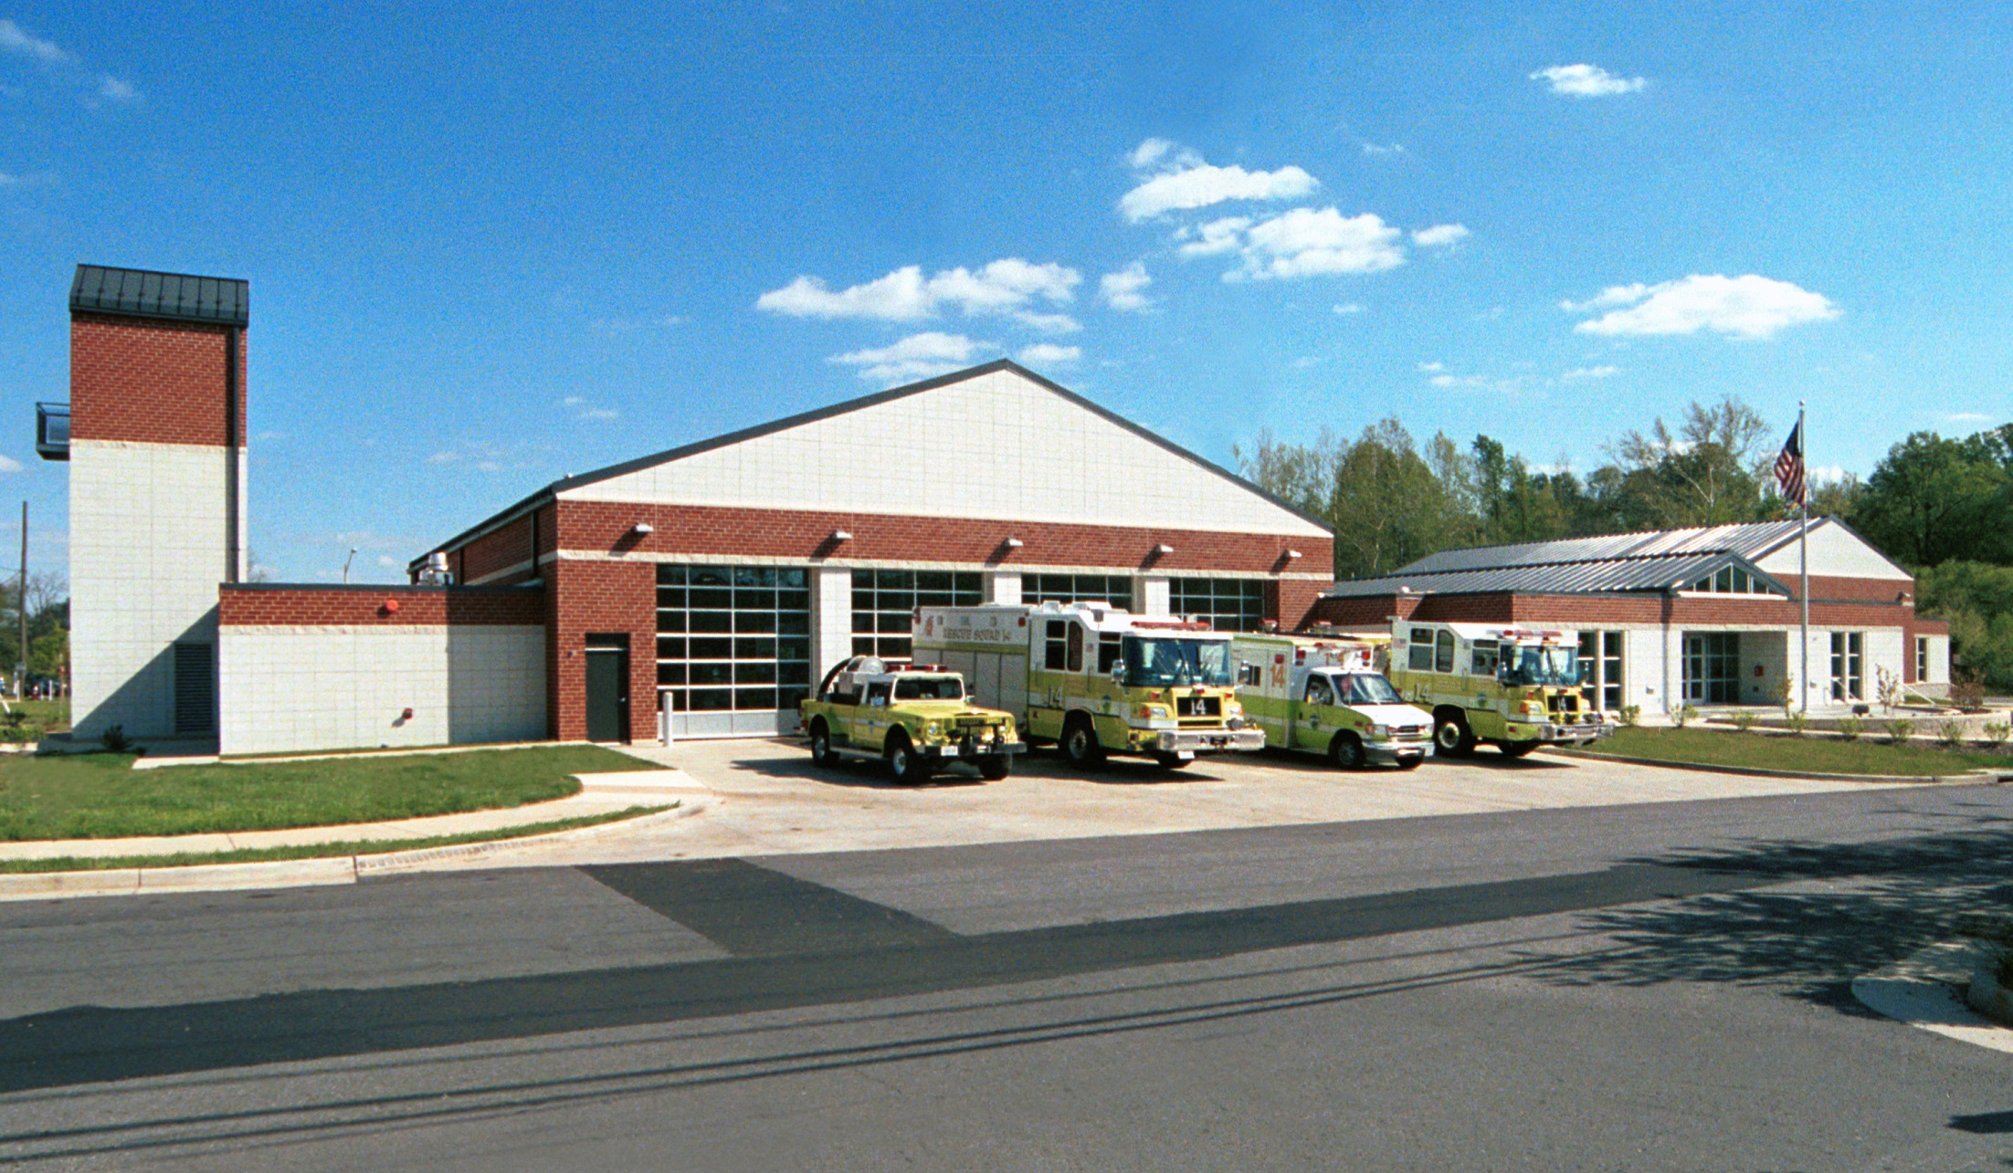
Burke (414)

Slide 33
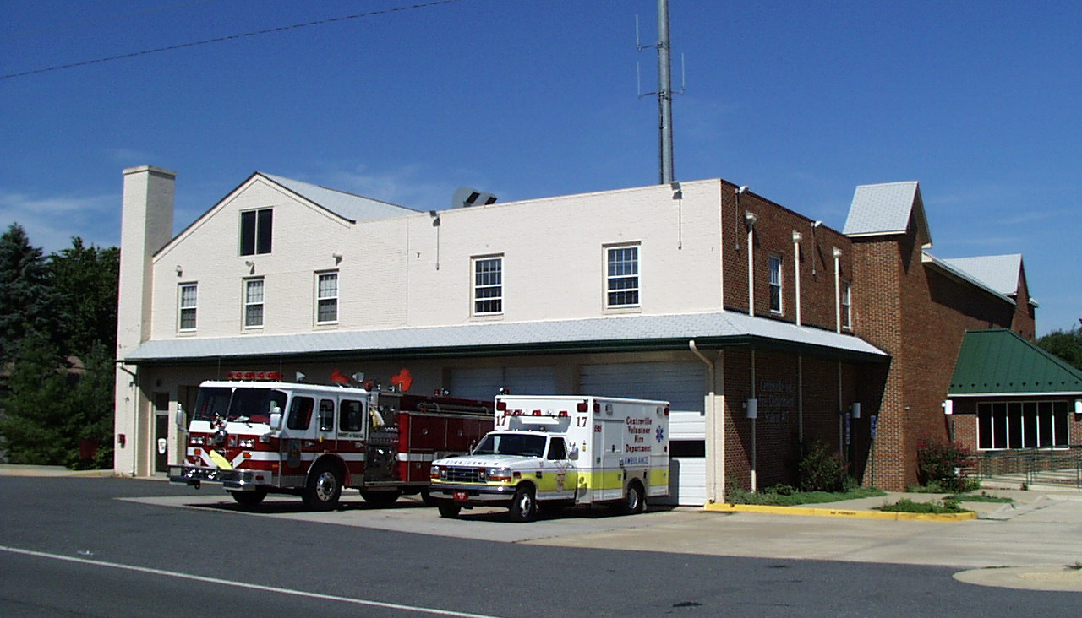
Centreville (417)

Slide 34
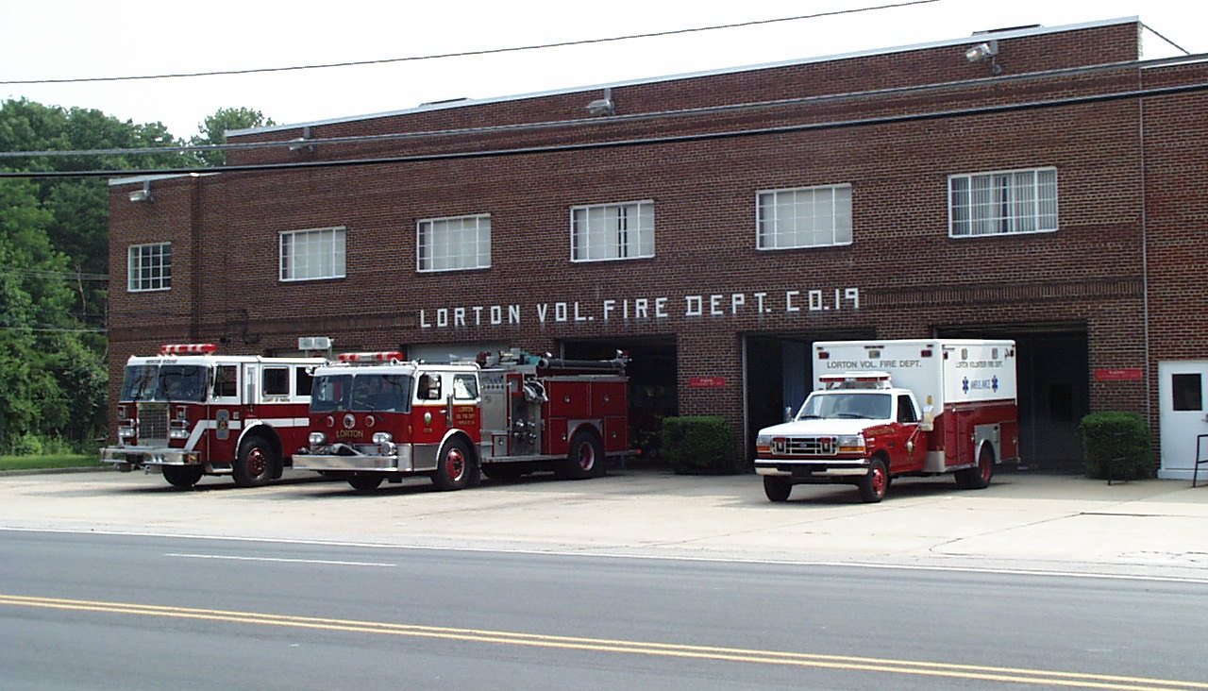
Lorton (419)

Slide 35
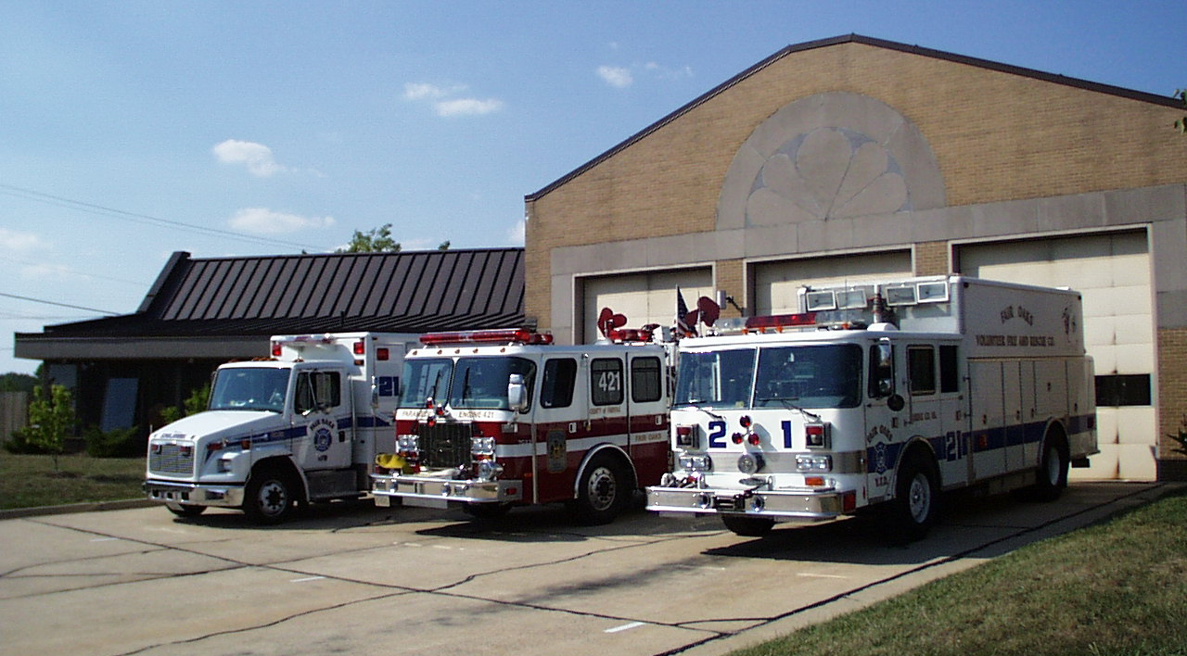
Fair Oaks (421)
Notes:
Station owned by the County

Slide 36
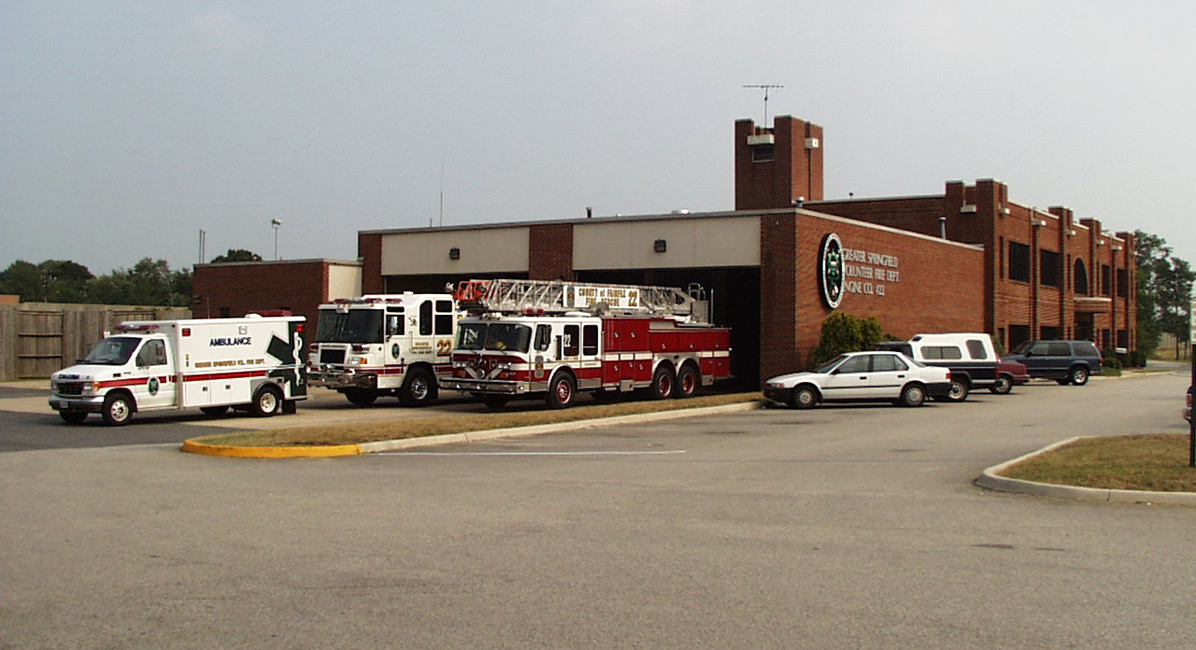
Greater Springfield (422)

Slide 37
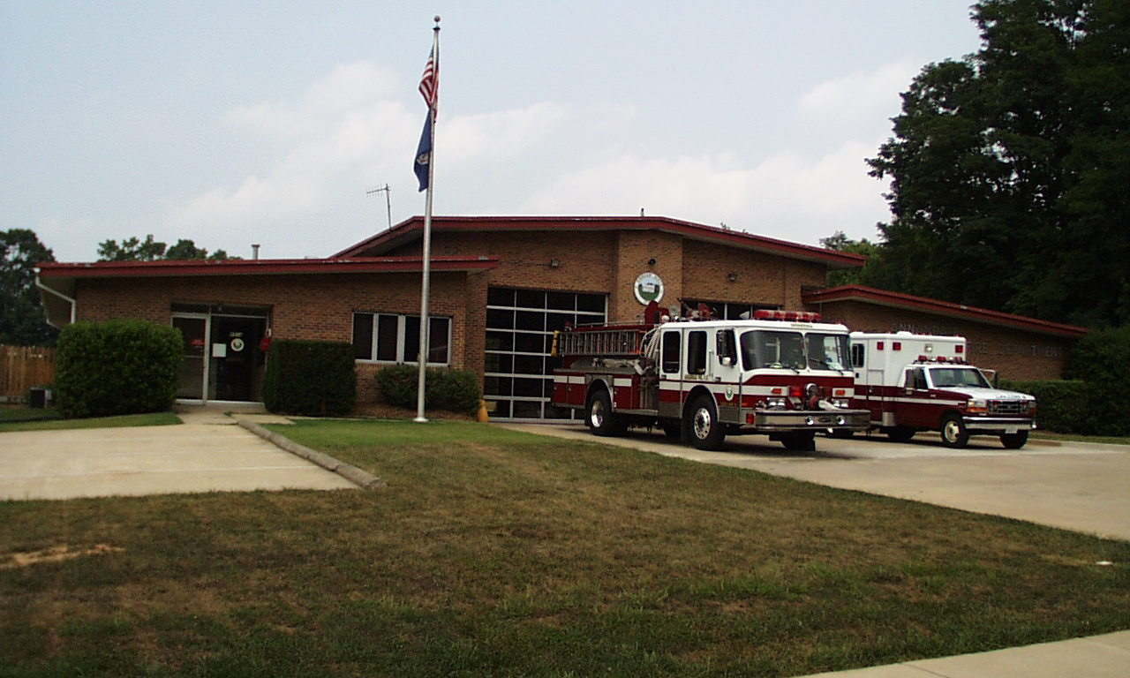
West Annandale (423)
Notes:
Owned by Station 8 -

Slide 38
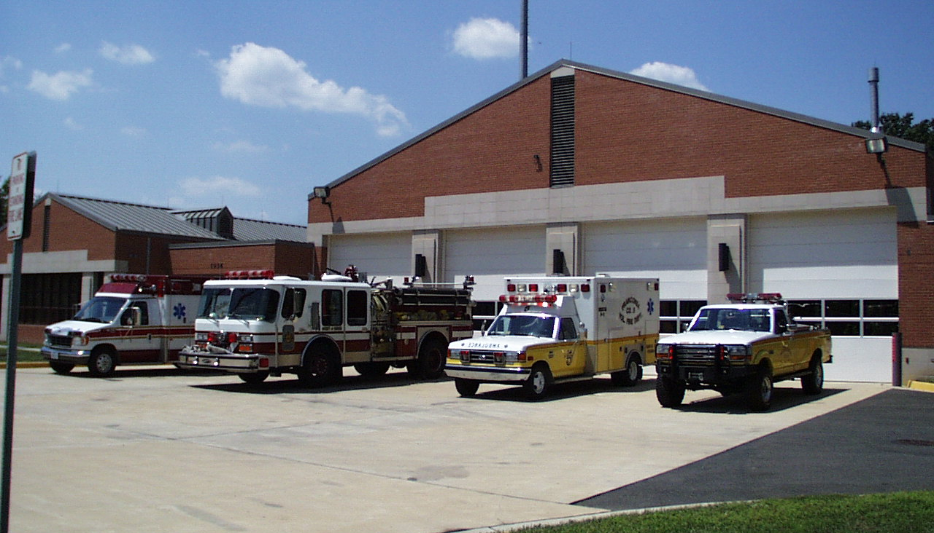
Kingstowne (437)
Notes:
Associated with Station 05

Slide 39
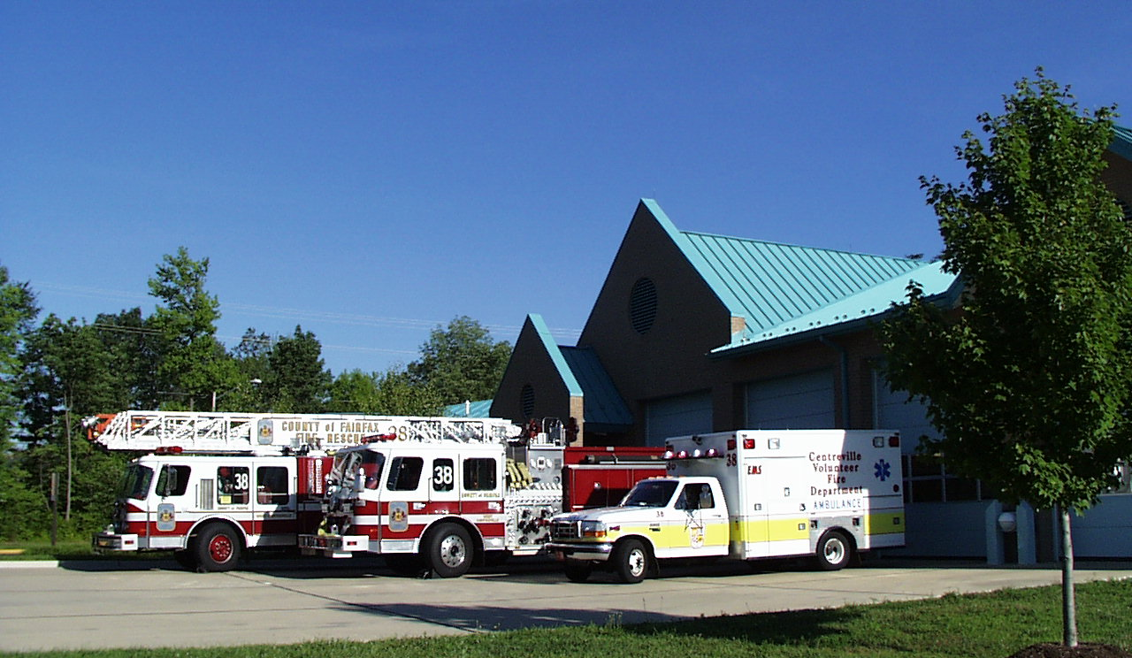
West Centreville (438)
Notes:
Associated with Station 17

Slide 40
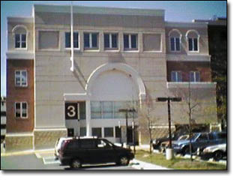
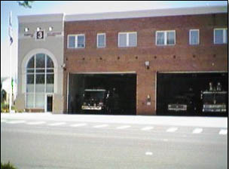
Fairfax City (03 / 33)
The City of Fairfax Fire Department is a combined career/volunteer force which provides fire suppression and emergency medical services both in the City proper and in a 14 square mile area of Fairfax County
Notes:
The Fairfax Volunteer Fire Department, Inc. , an integral part of the department, has an average of forty-five active members and twice that number serving as supporting members. Active members integrate within the system on a daily basis to both augment and fill-in for career staffing.
The department operates out of two stations with each providing full time - fully staffed suppression and emergency medical vehicles. Fire Station #3, located at 4081 University Dr., houses the duty Battalion Chief, a pumper, a ladder truck, a firefighting foam vehicle, and an advanced life support medical unit. A rescue engine and a advanced life support medical unit are assigned to Station #33 which is located at 10101 Fairfax Boulevard.

Slide 41
Take a Break

Slide 42
FxCo Volunteer Overview
12 independent tax-exempt organizations
Each Company provides at least two of the following to the County:
Buildings
Apparatus
Operational personnel
Operationally all volunteers serve under the County’s Fire Chief

Slide 43
Fairfax County Volunteer Fire & Rescue Department’s Mission Statement
Revised and Adopted November 1997
Volunteer Fire & Rescue Departments in Fairfax County serve the citizens by providing operational and financial support to the Fairfax County Fire and Rescue Department and by providing direct service to the other organizations which support the needs of the community.

Slide 44
Volunteer Utilization (What we do for the County) SOP 01.01.05 (10/19/2009)
Provide the following resources:
Trained, skilled personnel
Administrative, educational, and support programs
Buildings, grounds, and facilities
Apparatus, vehicles, tools, and equipment
Canteen and operational support activities

Slide 45
Volunteer Utilization Plan (Staffing - Frontline Units)
Certified volunteers may be utilized as minimum staffing on a short-term basis to keep a unit in service until the arrival of a detail or call-back employee.
Supplemental staffing shall be put in place on frontline units whenever possible (i.e., fourth on trucks) prior to placing additional units in service as this enhances the department’s ability to conduct emergency scene operations

Slide 46
Volunteer Utilization Plan (Staffing - Additional Units)
Additional operational units are placed in service with qualified volunteer personnel;
To backfill for units committed on extended emergency incidents, second alarm or greater incidents, out of service for scheduled training activities, or other assignments.
To provide coverage for scheduled public events such as Celebrate Fairfax, Bull Run Jamboree, etc.
To augment frontline units during inclement weather or other known or anticipated peak activity periods.
EMS transport units are encouraged to be placed in service with short notice to supplement EMS service.
Additional units may include specialty units such as canteens, brush units, or the rehab unit.

Slide 47
Volunteer Fire Commission
Deals with issues related to the volunteer sector of the Fairfax County F&RD
Top policy-making body within volunteer structure
Serves in advisory capacity to County Board of Supervisors and reports annually
Deals directly with Chief of Fairfax County F&RD
Seven member board
Meets 1st Wednesday of every month at FRA HQ

Slide 48
VOLUNTEER FIRE COMMISSION
Tim Fleming, Chair
Zone II Representing Companies 5, 19, 22
Term expires 7/2012
Shawn Stokes, Secretary
Fairfax Vol. Fire & Rescue Association Administrative/Support Representative
Term expires 7/2013
Gerry Strider, Vice-Chair
Zone I Representing Companies 2, 8, 10
Term expires 7/2012
Jeff Sargent
Fairfax Vol. Fire & Rescue Association Operations Representative
Term expires 7/2012
Robert Mizer
Zone III Representing Companies 14, 17, 21
Term expires 7/2013
Michael Masciola
Zone IV Representing Companies 1, 12, 13
Term expires 7/2013
Camilla Morrison
At-Large Representative
Term expires 7/2013

Slide 49
Volunteer Fire Commission
Annual Report
to the
Board Of Supervisors
for
Calendar Year 2010
May 24, 2011

Slide 50
VOLUNTEERS WHERE THEY LIVE

Slide 51
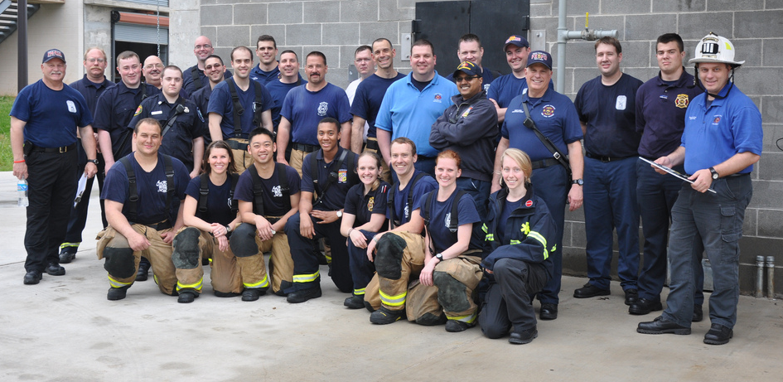
Volunteer Resources Personnel
413 Operational or Trainees
81,102 Operational Hours
39,283 Training Hours
269 Support Members
81,625 Admin Hours
Exceeded our commitment to the Volunteer Utilization Plan by placing units in service on 2114 occasions for 21,471 hours; and increase of about 10% over last year.

Slide 52
Personnel 2005-2010

Slide 53
Service Hours 2005-2010

Slide 54
Current Events
Operations
Well Defined Role
Increased Participation
Opportunity to Improve Community Service
Facilities
Great Falls VFD
Bailey’s Crossroads VFD
Fair Oaks
Recruitment and Retention
Increased Membership
SAFER Campaign Recruitment
SAFER Campaign - Retention

Slide 55
Areas of Concern
Continued growth of the volunteer organization
Stagnant Revenue from Fundraising
High Cost of Apparatus

Slide 56
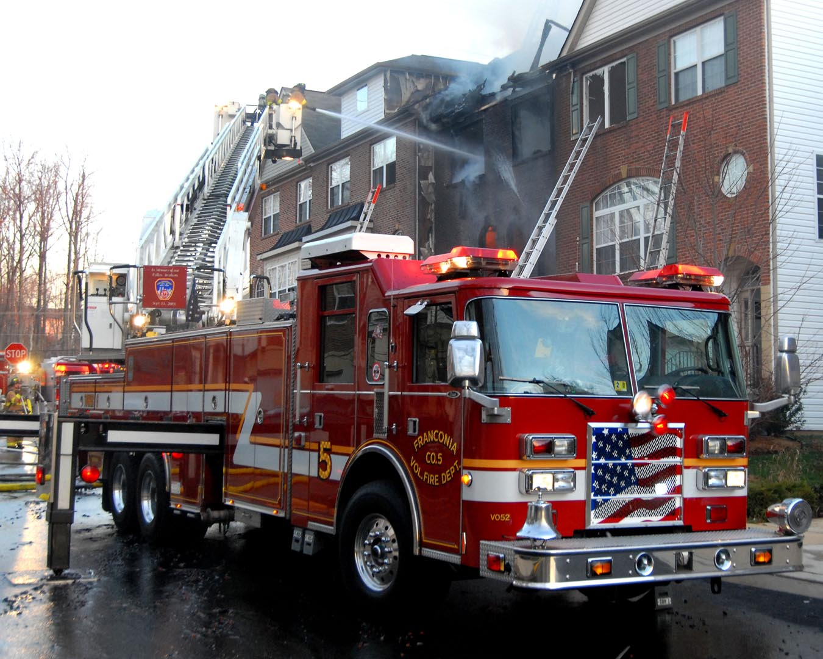
Volunteer Resources Apparatus
Volunteers own 94 vehicles with a replacement cost of nearly $31,129,657
31 Ambulances
23 Engines
4 Rescues
1 Tower ladder
1 Ladder truck
4 Canteens
5 Brush trucks
25 other vehicles

Slide 57
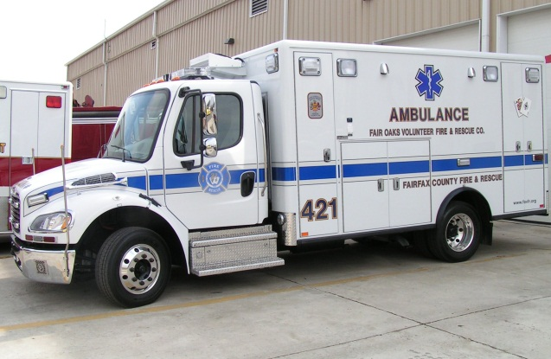
Volunteer Resources Apparatus
Placed in Service in CY 2010
1 Ambulances valued at $240,000
1 Engine valued at $523,000
2 Utilities valued at $105,000
Scheduled to be placed in service in CY 2011
7 Ambulances valued at $1,680,000
1 Engine valued at $588,000
1 Canteen valued at $128,000

Slide 58
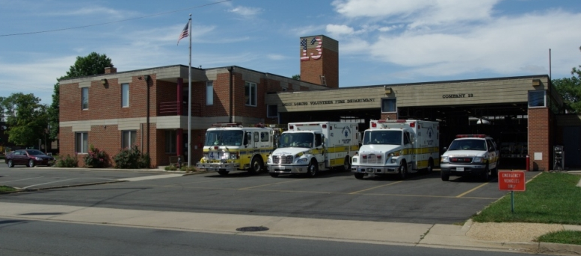
Volunteer Resources Capital Investment
10 Volunteer Owned Stations with a 2010 assessed value of $26,287,170
Partners in 5 County Owned Stations

Slide 59
Volunteer Contribution 2010
Apparatus Loan Payments $ 806,000
Mortgage Payments $ 582,000
Maintenance $ 568,675
One-Time Cash Payments $ 70,000
Volunteer Hours
(200,000 @ $22.00/hr) $ 4,400,000
Total $ 6,426,675

Slide 60
Fairfax County Volunteer Fire and Rescue Association (FxCo VFR Assoc)
Formed January 2003- combination of the Volunteer Chief’s Association and the Fire and Rescue Association

Slide 61
FxCo VFR Assoc
Provides input and feedback to the Fire Commission and Fire Department on all operational, administration and training issues affecting volunteers and volunteer participation
Standing Committees include:
Training Health and Safety
Human Resources Communications
Finance Public Relations
Social Activity

Slide 62
FxCo VFR Assoc
Represents the interests / benefits of all volunteers
Chief, President and 2 designated members per Company have voting rights. make up membership
All volunteers are invited and strongly encouraged to attend meetings
2nd Wednesday every month
Meetings rotate monthly among stations

Slide 63
Benefits
Injury, disability and death insurance
Comprehensive medical examinations (OHC)
Free annual physical for operational members
Death benefits from VFDs, State and Federal Government http://www.nvfc.org/benefits/state.php?State=Virginia
Personal property tax exemption
Operational Members get 10 free visits to county Recreation Centers per month
EMT, FF and Instructor / Officer courses are eligible for ACE Accreditation
http://165.176.249.179/higher_education/ACE_transcript_information.html
Notes:
Important to review the general insurance and accident benefits
Most are provided through Fairfax County, but some may be provided through your organization.
From our VFDs, we get pagers, email, uniforms, etc.
From the state and federal we get death benefits totaling in the 6 figures. (I think about $300k).
Relay the importance of reporting injuries and accidents immediately to the shift officer, Volunteer Chief and Volunteer Liaison, and thoroughly documenting the incident. Failure to do so could compromise benefits. The Volunteer Policies and Procedures Manual describes them in more detail (show them the manual and where it is kept in the station).
The personal property tax exemption is for those who provide at least 240 hours of active participation logged in blue book. To be eligible you must have been a member for one calendar year. The forms are completed and approved by the president and chief each January.
The Virginia Department of Fire Programs’ (VDFP) Pro Board certified courses are now available for ACE college accreditation. To receive ACE college credit recommendations for VDFP courses only, please follow the instructions below.

Slide 64
Volunteer Progression
Volunteer Rank | Op Status | Remarks
Applicant | Applicant | None
Recruit | Trainee | On completion VISIT and HIPAA able to ride on EMS Units as Ride-Along - OSERVES Only. On completion of Level 1A can also ride as observer on suppression units. Max 4 times per month
EMT Student | Trainee | HIPAA, VISIT, Level 1 and Class 1 physical start EMT Course Ride as EMS Student on ambulance / medic units Only participate to skill level covered in class
EMT | Operational | VA EMT certified Ride at level of training on Ambulance 3rd (straight out of EMS Course) / Driver / BLS Aide Ride on suppression units in addition to minimum staffing (Blue Hat) – assists with EMS duties, assist FF staff outside IDLH
BLS Driver /Aide | Operational | Need EVOC 2. Don’t have to be both but helps if you are
Recruit FF | Operational | Ride on suppression units in addition to minimum staffing – assists with EMS duties, assist FF staff outside IDLH (Wears Blue Gear)
FF/EMT | Operational | Ride at level of training on suppression and/or EMS units
Driver/Operator | Operational | Need EVOC 3 and Fire ground Hydraulics class and Driver Training Program Ride at level of training on suppression and/or EMS units
Unit Officer | Operational | Minimum 5 years as Minimum staffing FF
Command Officer | Operational | Minimum of 4 years as VUO

Slide 65
ALS Requirements
VOLUNTEER ALS STUDENT (VALSS) / VOLUNTEER ALS Only STUDENT (VALSOS)
To attend approved ALS course at Fairfax County Fire & Rescue’s expense:
VALSS - minimum staffing qualified.
VALSOS - minimum of 2 years as a Volunteer EMS Aide within a Fairfax County Volunteer Department and qualified as a Volunteer EMS Driver
Pass County’s pre-test requirements
You may take ALS school at your own expense
VOLUNTEER FF MEDIC INTERN (VFFMEDI) / VOLUNTEER ALS Only INTERN (VALSI)
VA EMT (I) or (P)
ITLS certified
ACLS certified
PALS certified
Personnel with VA EMT (I / P ) obtained at their own expense will also be required to complete the following:
Complete HIPAA & Security Training
Complete IS 700.a, IS 100.a & ICS 200
Complete Fairfax County EMS Billing and Documentation class
Qualified as EMS AIDE
EVOC 2
Notes:
To do ALS school at County’s expense will be required to sign document to
Upon completion of the course, enter and complete the ALS internship program within 15 months of receiving VAOEMS EMT-I certificate and enter an agreement to provide full ALS service for two recertification cycles for each ALS Certification (I or P) that was obtained at the county’s expense or pay back the tuition costs. This includes meeting minimum participation requirement of 60 hours per quarter.

Slide 66
Policies and Procedures
Volunteer Policy & Procedure Manual Chapter 1 Section 2D states:
Volunteer departments are independent corporations that serve as part of a network of 38 fire stations to deliver emergency services. To do so effectively, a number of guidance documents assure that services are delivered in a safe and consistent manner. These include the Code of Virginia, the Fairfax County Code, and Fairfax County Fire and Rescue Department General Orders (GOs), Standing Orders (SO), Standard Operating Procedures (SOPs), Regional Manuals, and this Volunteer Policies and Procedures Manual. In addition, each volunteer department establishes its own station policies and procedures.
Volunteers are subject to all operational regulations and administrative polices except those dealing exclusively with career civil service issues such as payroll, discipline, leave, and performance evaluations. Generally, the term employee when used in FRD guidance documents refers to both career and volunteer personnel.

Slide 67
Fairfax County Rules & Regulations
General Responsibilities
100.01 Knowledge of Regulations
Every employee is required to establish and maintain a working knowledge of all Standard Operating Procedures, Rules & Regulations, Operating Manuals, and General Orders of the Department.
All can be found on the FRD Intranet (only accessed on station PCs) and are also posted on VMS - Library - Fairfax County FRD which can be accessed at home
IT IS YOUR RESPONSIBILITY TO READ THEM
Notes:
Present the material of the next 8 slides in the context of character is a zero defect/zero tolerance effort.
Use recent examples of incidents in other, sometimes neighboring, jurisdictions and how they had a big impact on the violating member, their department and their community.
Go through the whole "If you make a mistake, own it, take the slap on the wrist and fix it. If you cover it up or lie about it, you're on your own and it will come out."
Include quick discussion on some potential problem areas that might come up. We then concluded with one of my favorite lines from the comedian Ron White: "We can fix a lot of things, but we can't fix STUPID."

Slide 68
100.01 Knowledge of Regulations
In the event of improper action or breach of discipline, it will be presumed that the employee was familiar with the SOP, regulation, or order in question.
Violation of any SOP, regulation, or order may be grounds for disciplinary action.
All relevant Rules & Regulations; Standing Orders, SOPs, GOs etc. can be found on the FRD Intranet (only accessed on station PCs) and are also posted on VMS - Library - Fairfax County FRD which can be accessed at home
IT IS YOUR RESPONSIBILITY TO READ THEM

Slide 69
100.02 County Personnel Regulations
Employees of the Department shall be governed by the County Personnel Regulations unless they are specifically exempted. Each employee of the Department is required to familiarize himself/herself with these rules.
All relevant Rules & Regulations; Standing Orders, SOPs, GOs etc. can be found on the FRD Intranet (only accessed on station PCs) and are also posted on VMS - Library - Fairfax County FRD which can be accessed at home
IT IS YOUR RESPONSIBILITY TO READ THEM

Slide 70
100.03 Obedience to the laws & Regulations
All employees shall observe and obey all laws, all rules & regulations of the Department, and all General Orders & SOP’s of the Department.
All relevant Rules & Regulations; Standing Orders, SOPs, GOs etc. can be found on the FRD Intranet (only accessed on station PCs) and are also posted on VMS - Library - Fairfax County FRD which can be accessed at home
IT IS YOUR RESPONSIBILITY TO READ THEM

Slide 71
100.04 Chain of Command
The unbroken line of authority extends from the County Executive, to the Fire Chief, and through a single subordinate at each level of execution. The chain of command is the proper route for vertical communication among Department members.

Slide 72
100.05 Performance of Duty
All employees shall perform their duties as required or directed by law, SOP, Department Rule, Operating Manual, General Order, or by order of a superior officer.

Slide 73
100.06 Human Relations
Every employee is expected to perform their duties in an efficient, courteous, and orderly manner, employing patience and good judgment at all times. All employees shall refrain from harsh, profane, or insolent language or acts, and shall be courteous and civil in their dealing with others. Displays of bias toward any person on account of race, sex, religious preference or life-style shall be considered unbecoming conduct.

Slide 74
100.08 Reporting Violations
Any person “employee” who has knowledge of other employees knowingly or unintentionally violating any laws, SOP’s, rules & regulations of the Department, or who are disobeying orders, shall bring and all facts pertaining to the matter to the attention of a superior officer.

Slide 75
Your Responsibility
Consider what’s best
Report / Not to report?
Requirement to report?
Don’t “pass the buck” be responsible
Always Remember: “It’s not poor performance that creates problems, it’s poor character!”
Suggestion! Don’t get yourself in trouble just because someone else gotten themselves into trouble.

Slide 76
200.19 Unbecoming Conduct
Employees SHALL conduct themselves at all times, both ON & OFF DUTY, in such a way as to reflect most favorably on the Department. Conduct unbecoming shall include that which brings the department into disrepute or reflects discredit upon the employee as a member of the department or that which impairs the operation or efficiency of the department or employee.

Slide 77
400 Administrative Activities
400.02 Falsifying Reports
Employee’s shall not knowingly falsify any official report, (including oral or radio report) or enter, or cause to be entered, any inaccurate, false or improper information in official records of the Department.
400.03 Altering Reports
Shall not alter or request any other person to alter or withdraw any report, letter, request...shall advise, counsel, order or dissuade another from submitting any lawful report.
400.04 Security of Official Records
...Shall not reveal...information contained in records, correspondence accessible only to employees and is considered confidential, GROSS MISCONDUCT. Station logbooks is the exception.

Slide 78
500.01 Reporting Arrests & Court Actions
All employees SHALL report their involvement in an arrest or a pending criminal action WITHIN 24 HOURS to their Volunteer Chief.

Slide 79
200.08 Intoxicants on Departmental Premises
Employees shall not bring any intoxicants on Departmental premises. Intoxicants shall not be transported in any Fire & Rescue vehicles.
This includes Volunteer Stations and Volunteer owned apparatus

Slide 80
200.09 Intoxicants Purchase & Consumption
Employees shall not consume intoxicants while off-duty to the extent that evidence of such consumption is apparent when reporting for duty or to the extent that the ability to perform on duty is impaired. In addition, wearing the Department uniform, or parts thereof, while consuming or purchasing intoxicants is prohibited.

Slide 81
200.10 Intoxication
Employees shall not report for duty under the influence of any intoxicant or consume any intoxicant while on duty.

Slide 82
SOP: 02.04.03 FITNESS FOR DUTY
Factors that impair an employee’s ability to perform their duties.
Alcohol / Illicit Drugs
Injury or Illness
Psychological Impairment
Inability to Physically Perform
An employee w/ a positive BAC shall be considered impaired.
Testing positive for drugs is impairment.

Slide 83
200.18 Truthfulness
All employees SHALL supply complete and truthful information when questioned by any authority in the chain of command.
The questioning shall be relevant to the performance of the employee’s official duty and/or fitness to perform such duty.

Slide 84
SOP: 02.09.07 DRIVER’S LICESNE REQUIREMENTS:
Virginia Traffic Code requires operator’s license.
FRD requires all employees to have operator’s license.
Must report suspension, revocation or restriction
Cannot “be operational” w/o operator’s license.

Slide 85
Code of Virginia
12 VAC 5-31 – 910
EMS Personnel Requirements and Standards of Conduct
EMS personnel may not act as an operator of an EMS vehicle if they have been convicted of the charge:
1. DUI / DWI - alcohol or drugs
Assign to ASAP
Felony
Hit & Run
Suspended or Revoked operator’s license
Prohibited from driving EMS vehicle for a period of 60 months which means UNEMPLOYMENT! (NON-OPERATIONAL for Volunteers)

Slide 86
FRD Administrative SOPs
01.00 General[1/2009]
01.00.01 Written Department Communications [1/2009]
01.01 Command and Structure[1/2009]
01.01.01 Chain of Command for Field Operations [1/2009]
01.01.02 Volunteer Chiefs/Command Officers [1/2009]
01.01.03 Staffing Procedures [3/2011]
01.01.04 Flexible Staffing [1/2009]
01.01.05 Volunteer Utilization [10/2009]
01.01.07 Volunteer Resource Officer Program [1/2009]
01.08.01 Use of County-Owned Vehicles [7/2011]

Slide 87
FRD Personnel SOPs
02.00.04 Sexual Harassment [1/2009]
02.00.05 Discrimination [1/2009]
02.00.06 Oral and Written Reprimands [1/2009]
02.00.13 Employee Relations [1/2009]
02.00.14 Workplace Violence [1/2009]
02.03.01 Personal Injury Reporting [1/2009]
02.03.02 Survivor Information Form (FRD-017) [3/2010]
02.03.03 Occupational Contaminant Exposures [1/2009]
02.03.04 Personnel Safety [1/2009]
02.03.05 Repair or Replacement of False Teeth and Eye Glasses [5/2011]
02.03.07 Critical Incident Stress Debriefing Program [1/2009]
02.03.08 Employee Assistance Program [1/2009]
02.03.09 Fitness Program [1/2009]
02.03.11 Emergency Evacuation of Personnel [1/2009]
02.03.12 Designated Areas for Tobacco Use [1/2009]
02.09.05 Procedures for Employees Involved in an Arrest, Criminal or Civil Court Action [6/2010]
02.09.07 Driver's License Requirements [1/2009]
02.09.09 Grooming [1/2009]

Slide 88
Terminology Ranks/Personnel
Rookie - Recruit firefighter
Firefighter - Basic rank; requires EMT and Firefighter certifications
Technician - First level of promotion within Fairfax County; besides EMT Fairfax also has Technician Driver, Hazmat, and Technical Rescue
EMT-B – Minimum qualification held by all operational personnel
EMT-I (Intermediate) - Assigned to medic units or engines
EMT-P (Paramedic) - Assigned to medic units or engines

Slide 89
Terminology Ranks/Personnel (continued)
Master Technician - Senior technician; can fill in for officers and teaches in the station
Lieutenant - Company level officer; commands a squad or truck company
Captain I - Company level officer; may also be a shift leader
Captain II - OIC of a department company or station

Slide 90
Terminology Ranks/Personnel (continued)
Battalion Chief - Commands a single battalion
Deputy Chief - A, B & C Shift, Special Operations, Support Services, Training Division & Fire Prevention
Assistant Fire Chief - Joint second in commands Operations & Support
Fire Chief - Highest rank of the department

Slide 91
Career Badges
Recruit
Probationary Firefighter
Firefighter
Technician
Master Technician

Slide 92
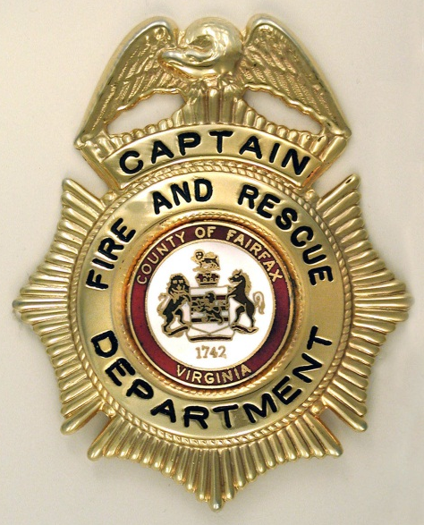
Lieutenant
Captain I
Captain II
Battalion Chief

Slide 93
Deputy Chief
Assistant Chief
Fire Chief

Slide 94
Terminology
Some Important Ones – see handout on CD for a fuller list
Chain of Command
Command Post
Officer in Charge (O.I.C.)
Senior Staff
Shift
Battalion
Company
Engine Company
Reserve Apparatus
Alarm
Arson
Initial Attack
Backdraft
Box
Box Map
“Fill the box.”

Slide 95
Terminology (continued)
Bugles
C.A.D. (Computer Aided Dispatch)
Conflagration
CISD (Critical Incident Stress Debriefing)
Uniformed Fire Officer (UFO)
P.S.C.C. (Public Safety Communication Center)
First Alarm
First Due
First Due Area or Territory
Standard Operation Procedure (S.O.P.)
Gear

Slide 96
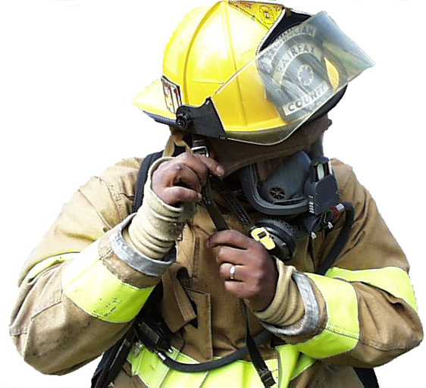
Terminology (continued)
Helmet Shield
Hose Tower
Knock-down
Log Book
M.C.I. (Mass Casualty Incident)
P.A.S.S. (Personal Alert Safety System)
Passport
Plug
RIT (Rapid Intervention Team)
Salvage
Sectors

Slide 97
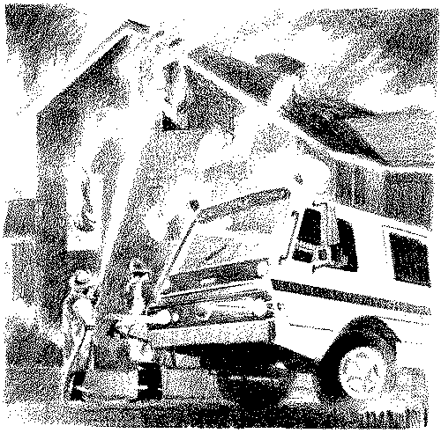
Terminology (continued)
Strategy
Tactics
Two-In, Two-Out
“Working Fire”

Slide 98
Take a Break

Slide 99
Apparatus

Slide 100
Vehicle Types
Types of Front Line Units
Engine
Rescue Engine
Rescue Squad
Truck
Tower
Aerial
Medic/Ambulance

Slide 101
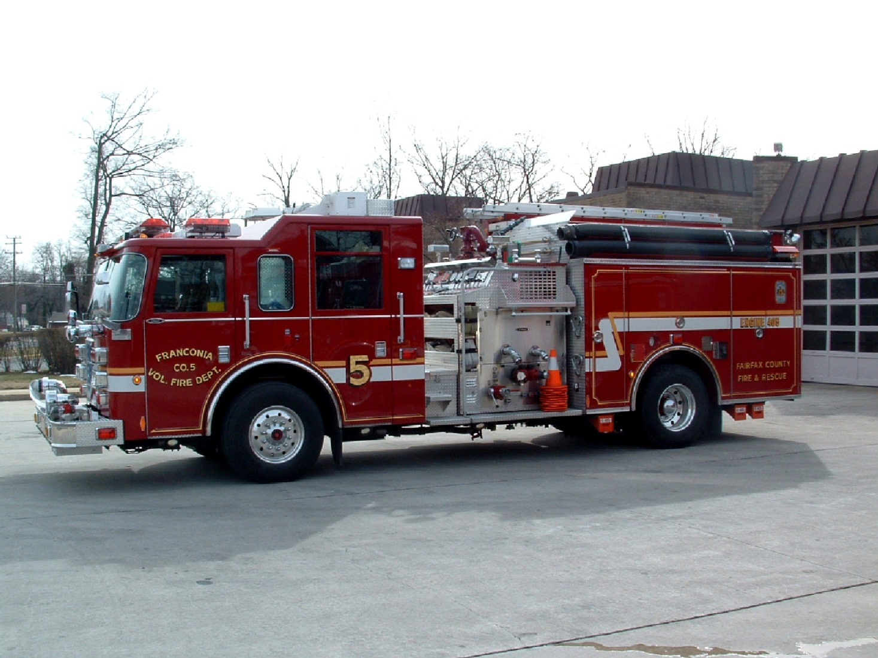
Engine
Staffing: Officer, Apparatus Tech,
FF Medic, & FF
Notes:
Come in all different shapes and sizes
See next slide

Slide 102
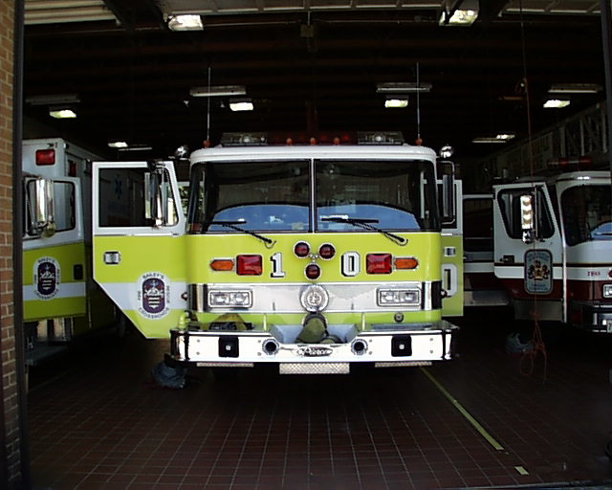
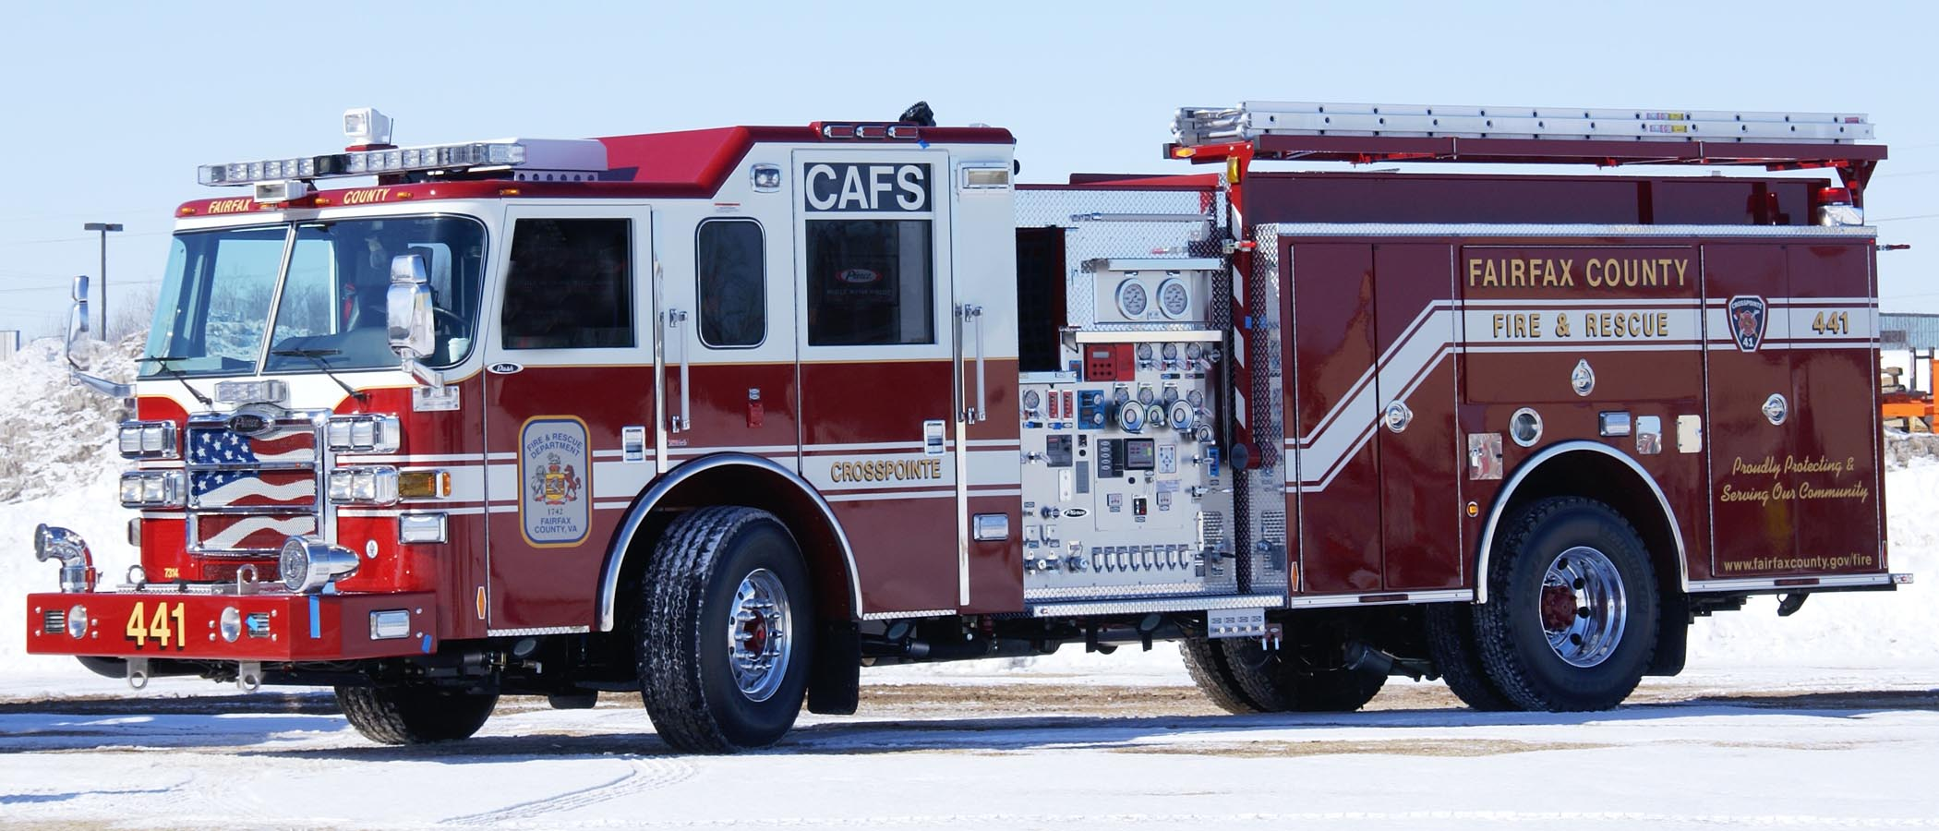
Notes:
Vehicles come in many colors; County owned vehicles are the red & white ones, lower left hand, but so are some volunteer ones

Slide 103
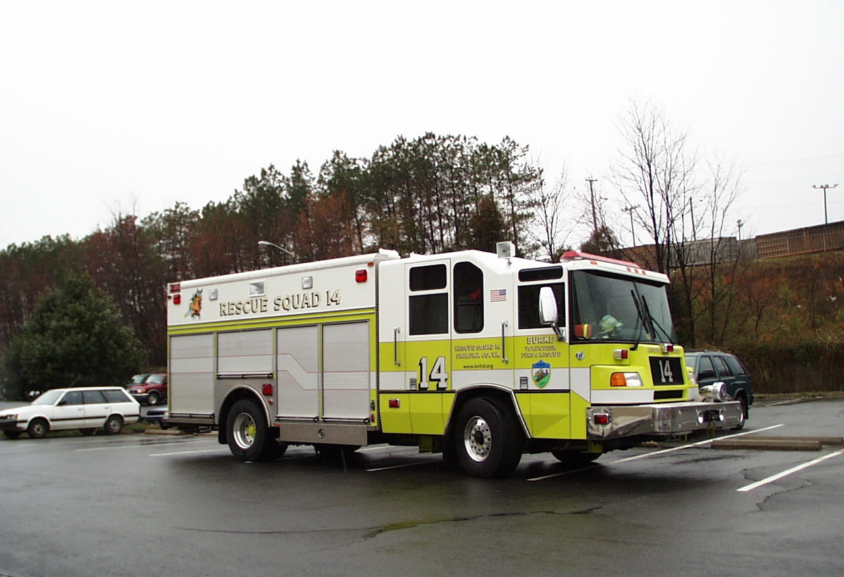
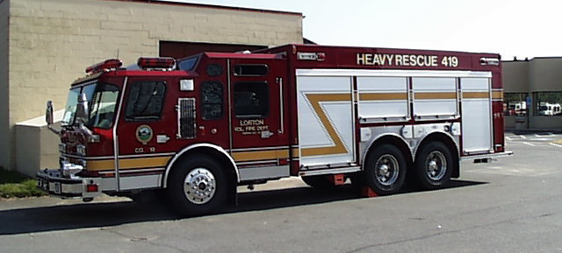
Rescue Squad
Staffing: Officer, Apparatus Tech,
& 2 TROT / HRMT Technicians
Notes:
1 Technician can be filled by FF with appropriate specialty certification
1, 11, 19 & 26 are HazMat
14, 18, 21 & 39 are TROT

Slide 104
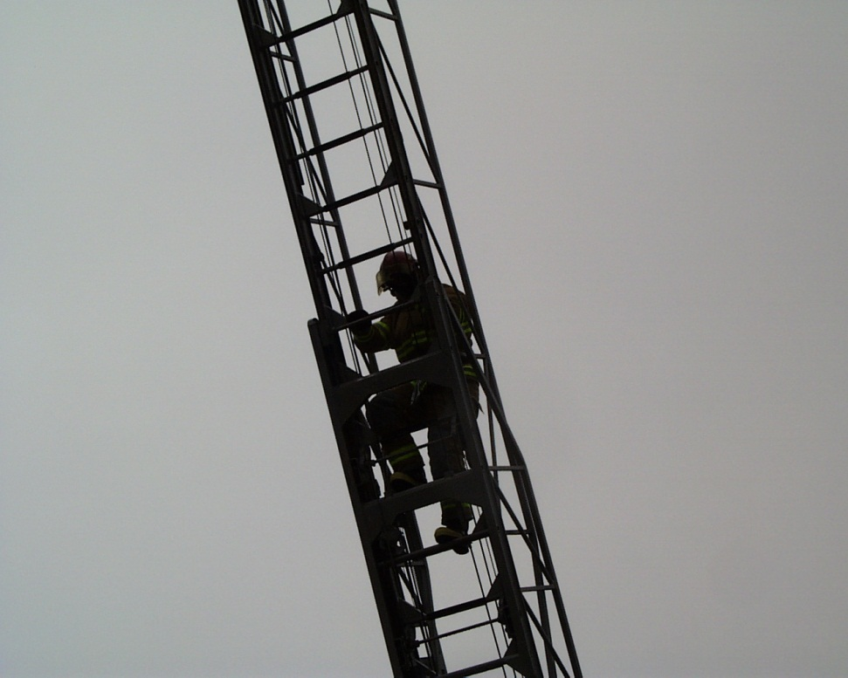
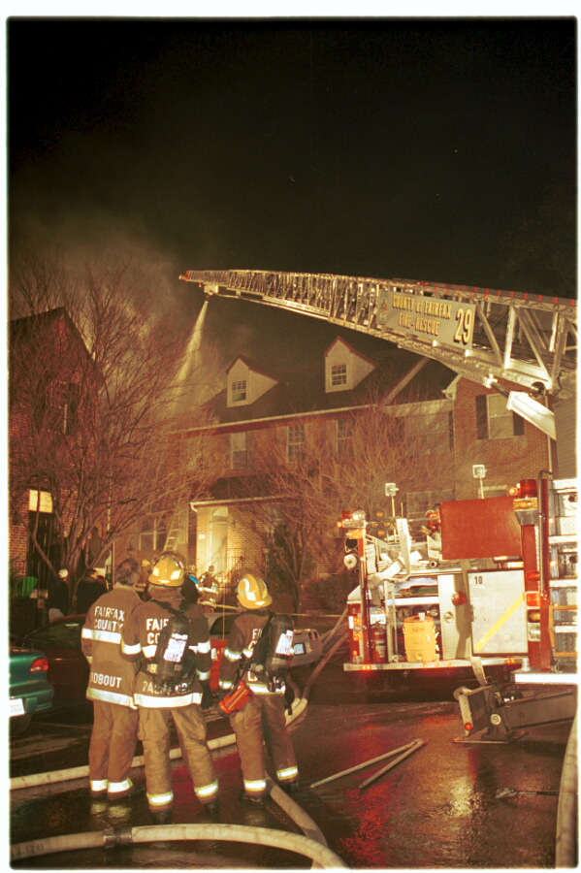
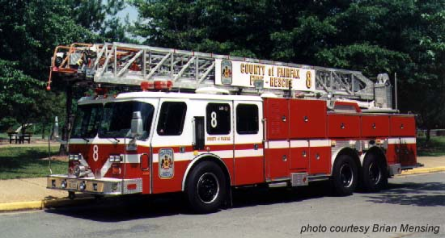
Truck
Staffing: Officer, Apparatus Tech,
& FF

Slide 105
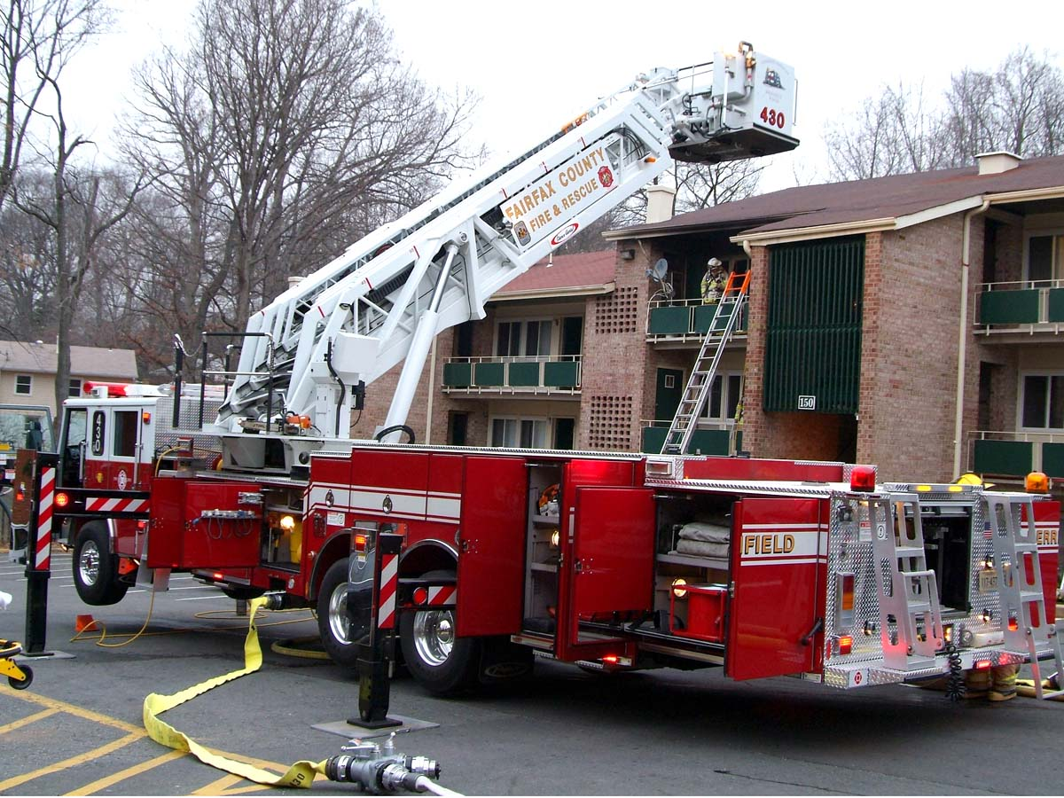
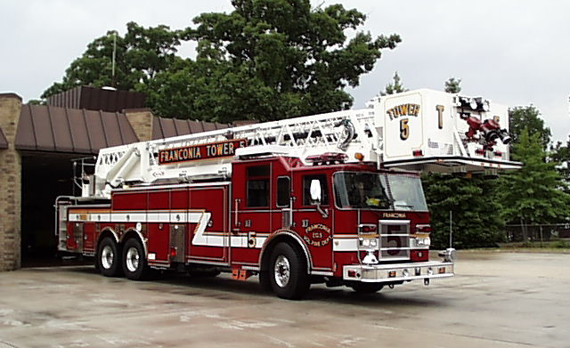
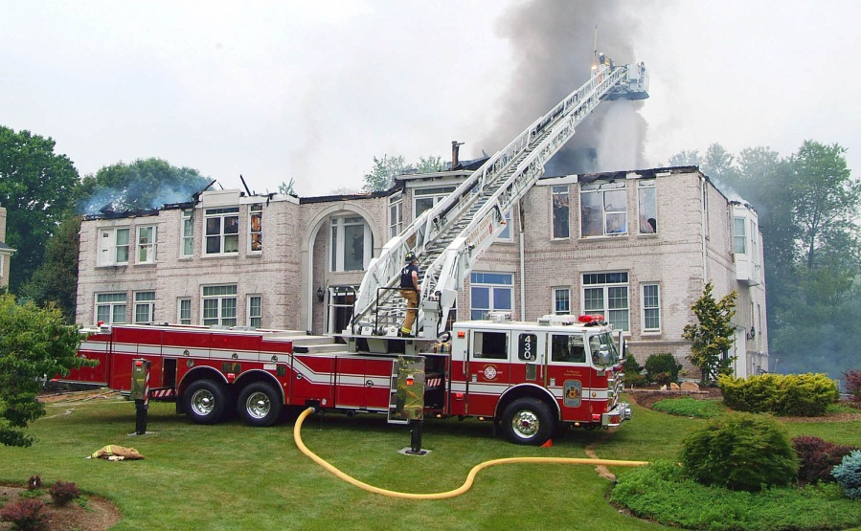
Tower
Staffing: Officer, Apparatus Tech,
& FF

Slide 106
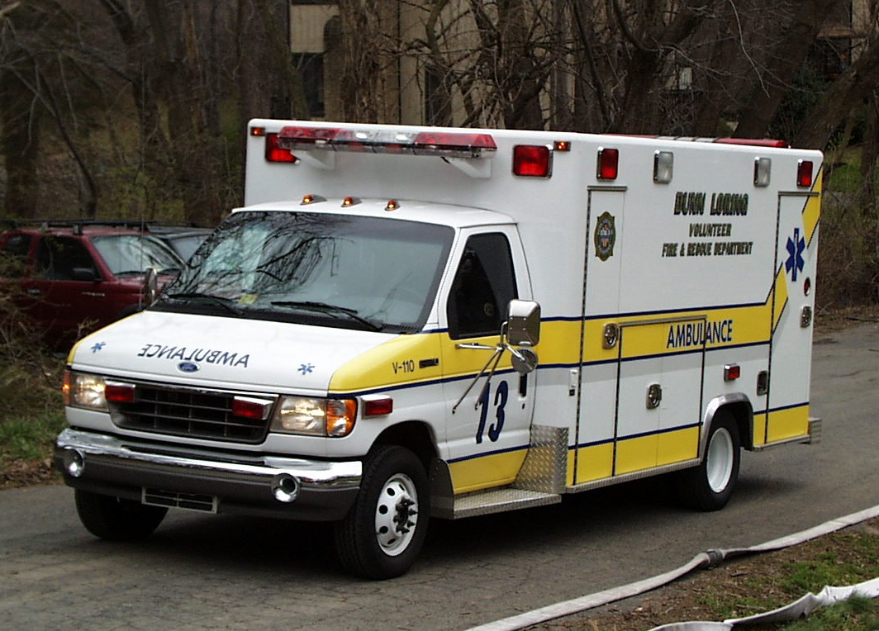
Ambulance/Medic
38 Medic transport units
27 have 1 ALS and 1FF/EMT as Driver
14 will be training units with 2 ALS providers plus intern
4 BLS Units
1 Aide & 1 driver
Volunteer BLS Units
1 Aide & 1 Driver
Notes:
Note: new EMS Delivery Module calls for all 41 career transport units to be ALS
27 will have 1 ALS and 1FF/Driver
14 will be training units with 2 ALS providers + intern
Only 4 career BLS units at 8, 9, 10 & 11 – these could disappear in the net budget
BLS falls to the Volunteer Units

Slide 107
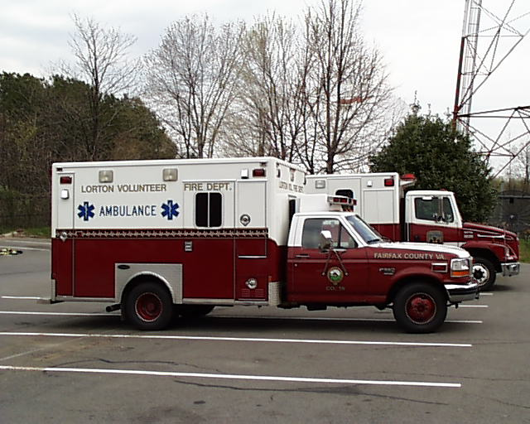
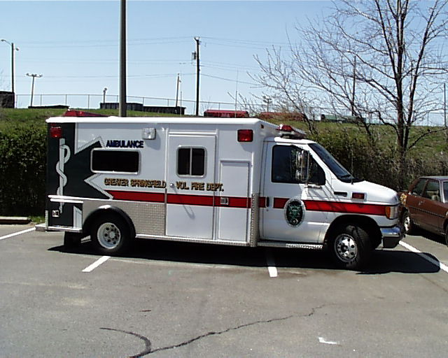
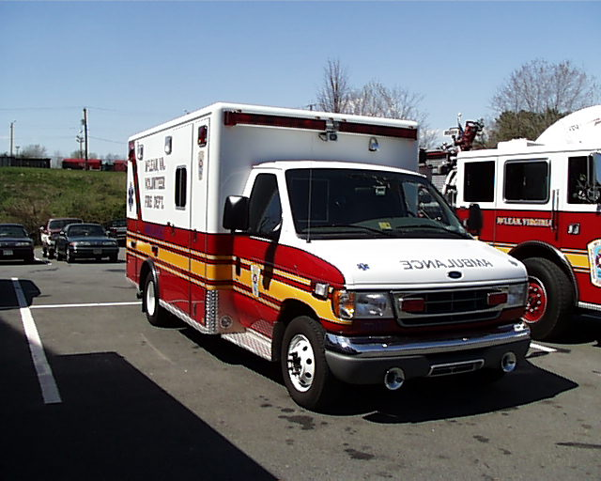

Slide 108
Auxiliary Units
Hazmat
Foam Units
Tanker
Support Units
Mobile Air
Light & Air
Field Communications
Medical Support
Command “Buggies”
Brush
Utility
Boat
Canteen
Rehab Unit
Medical Ambulance Bus
Mobile Training Lab

Slide 109
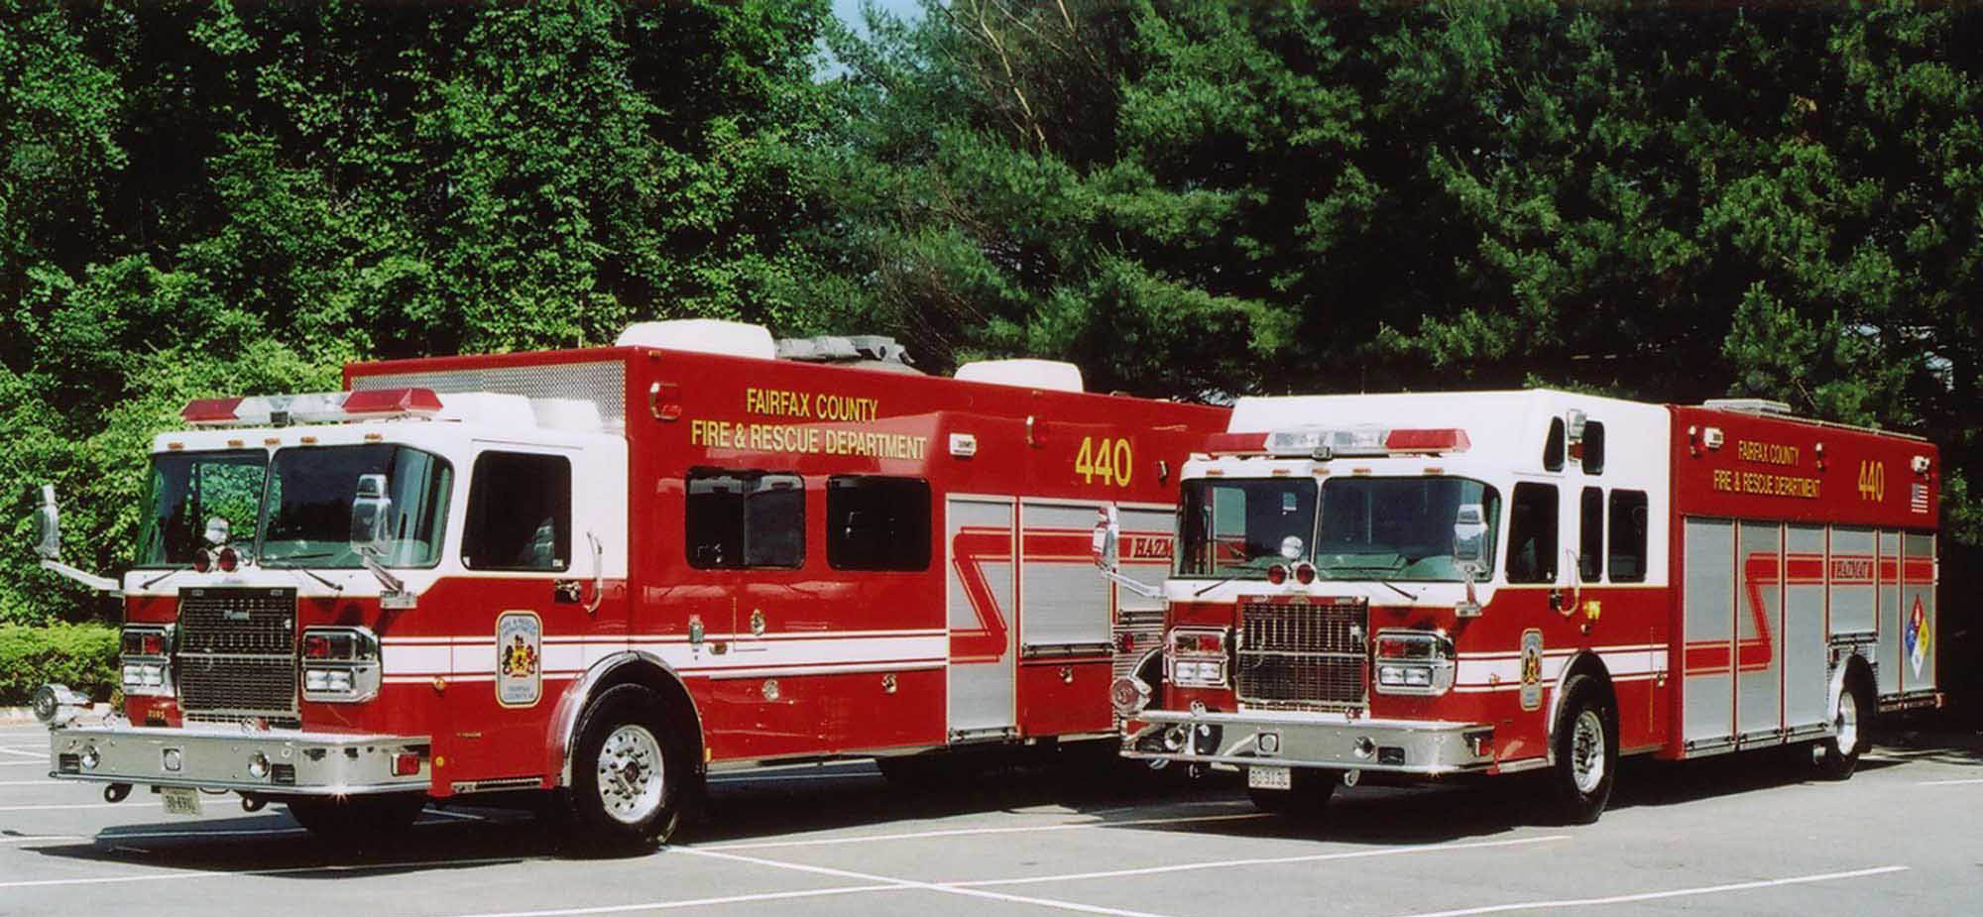
HAZMAT 440 w/ Support Unit

Slide 110
Tanker

Slide 111
Support Units
Mobile Air Unit
Light & Air Unit
Field Communications Unit
Medic Care Support Unit

Slide 112
Command Buggies

Slide 113
Brush

Slide 114
Utility Vehicles

Slide 115
Boats

Slide 116
Canteen Vehicle

Slide 117
Rehab Unit
Notes:
See GO 2009-048 – housed at FS 413

Slide 118
Medical Ambulance Bus

Slide 119
Mobile Training Lab

Slide 120
History: Fairfax County Fire and Rescue Department
1912 First Mention of the Fire Department in
County Records
1932 First Ambulance
1940’s World War II - First “Fire Chief”
1949 Ten Paid Men--Drivers, Day Time Only
1953 The first Fairfax County squad goes in service at Fire Station 11
1954 Fire Marshal’s Office Established

Slide 121
Growth Through Sponsorship
1950s Original group of volunteer stations would require any new fire station to be sponsored by an existing company
Companies 1 (McLean) & 4 (Herndon) sponsored Station 12 (Great Falls)
Company 3 (Fairfax City) sponsored Station 14 (Burke), Station 16 (Clifton), & Station 17 (Centreville)
Company 4 (Herndon) sponsored Station 15 (Chantilly) & Station 21 (Fair Oaks)
Company 5 (Franconia) sponsored Station 22 (Springfield)
Company 6 (Falls Church) sponsored Station 13 (Dunn Loring)

Slide 122
History
1963 First county-owned piece of fire apparatus, a 85’ straight ladder truck manufactured by Maxim was purchased & assigned to Station 11 (Penn Daw). Now restored by off-duty firefighters, it serves as the department’s historical piece of equipment

Slide 123
History
1965 Completed construction & occupied its first Training Center which included:
an administrative building for 2 classrooms, offices, and a small kitchen…

Slide 124
History
It also included 2 structures for fire training simulations; open pits for simulation of fuel fires; roadways for driver training; open fields for fire & emergency medical training evolutions; & a small garage for training apparatus & equipment

Slide 125
History: Fairfax County Fire and Rescue Department (cont.)
1968 County’s only line-of-duty death (Earl Warren Kane)
1971 First African American firefighter hired by the county
1974-5 NOVA (Northern Virginia Regional Response Agreement) in effect
1978 May - Fairfax City Withdraws from County Fire Association
1979 First woman hired (Christine Donovan)

Slide 126
History: Fairfax County Fire and Rescue Department (cont.)
1987 June 28th - Computer aided dispatch (C.A.D.) in service
1989 The Fire Prevention Division established the first canine accelerant detection program in the D.C. metro area by acquiring “Ebby” a female black Labrador
1989 First TROT deployment - Armenia after earthquake

Slide 127
History: Fairfax County Fire and Rescue Department (cont.)
1992 All divisions move to the Massey building
2000 800 MHz radios and MCTs are in service
2006 Re-Organization
3 Assistant Chiefs
7th Battalion
2007 Chief Mastin appointed Fire Chief
Fire Prevention Division moves to Burkholder Building

Slide 128
National Organizations
CHEMTREC (Chemical Transportation Emergency Center)
I.S.O. (Insurance Services Office)
I.A.B.P.F.F (International Association of Black Professional Firefighters)
I.A.F.C. (International Association of Fire Chiefs)
I.A.F.F. (International Association of Fire Fighters)

Slide 129
National Organizations (continued)
National Fire Academy
N.F.P.A. (National Fire Protection Association)
WFS (Women in the Fire Service)

Slide 130
Former County Fire Chief’s
1964 – 1971 Willis H. Burton
1971 – 1983 George M. Alexander
1983 – 1991 Warren Isman
1991 – 1998 Glenn A. Gaines
1998 – 2003 Edward L. Stinnette
2003 – 2007 Michael P. Neuhard

Slide 131
Finished

